Slide 1
How to Develop and Implement a Data Governance Program from a Local Public Health Informatics Perspective
MECKLENBURG COUNTY
Public Health Informatics Program
Jonathan Ong | Lauren Cook
Sr. Health Program Manager Management Analyst

Slide 2
Session Goals
Review roadmap for developing and implementing a data governance program
Introduce data quality during early stages of implementation
Identify framework for data standardization
Overcome implementation roadblocks
Tools and recommendations for a data governance
Q&A

Slide 3
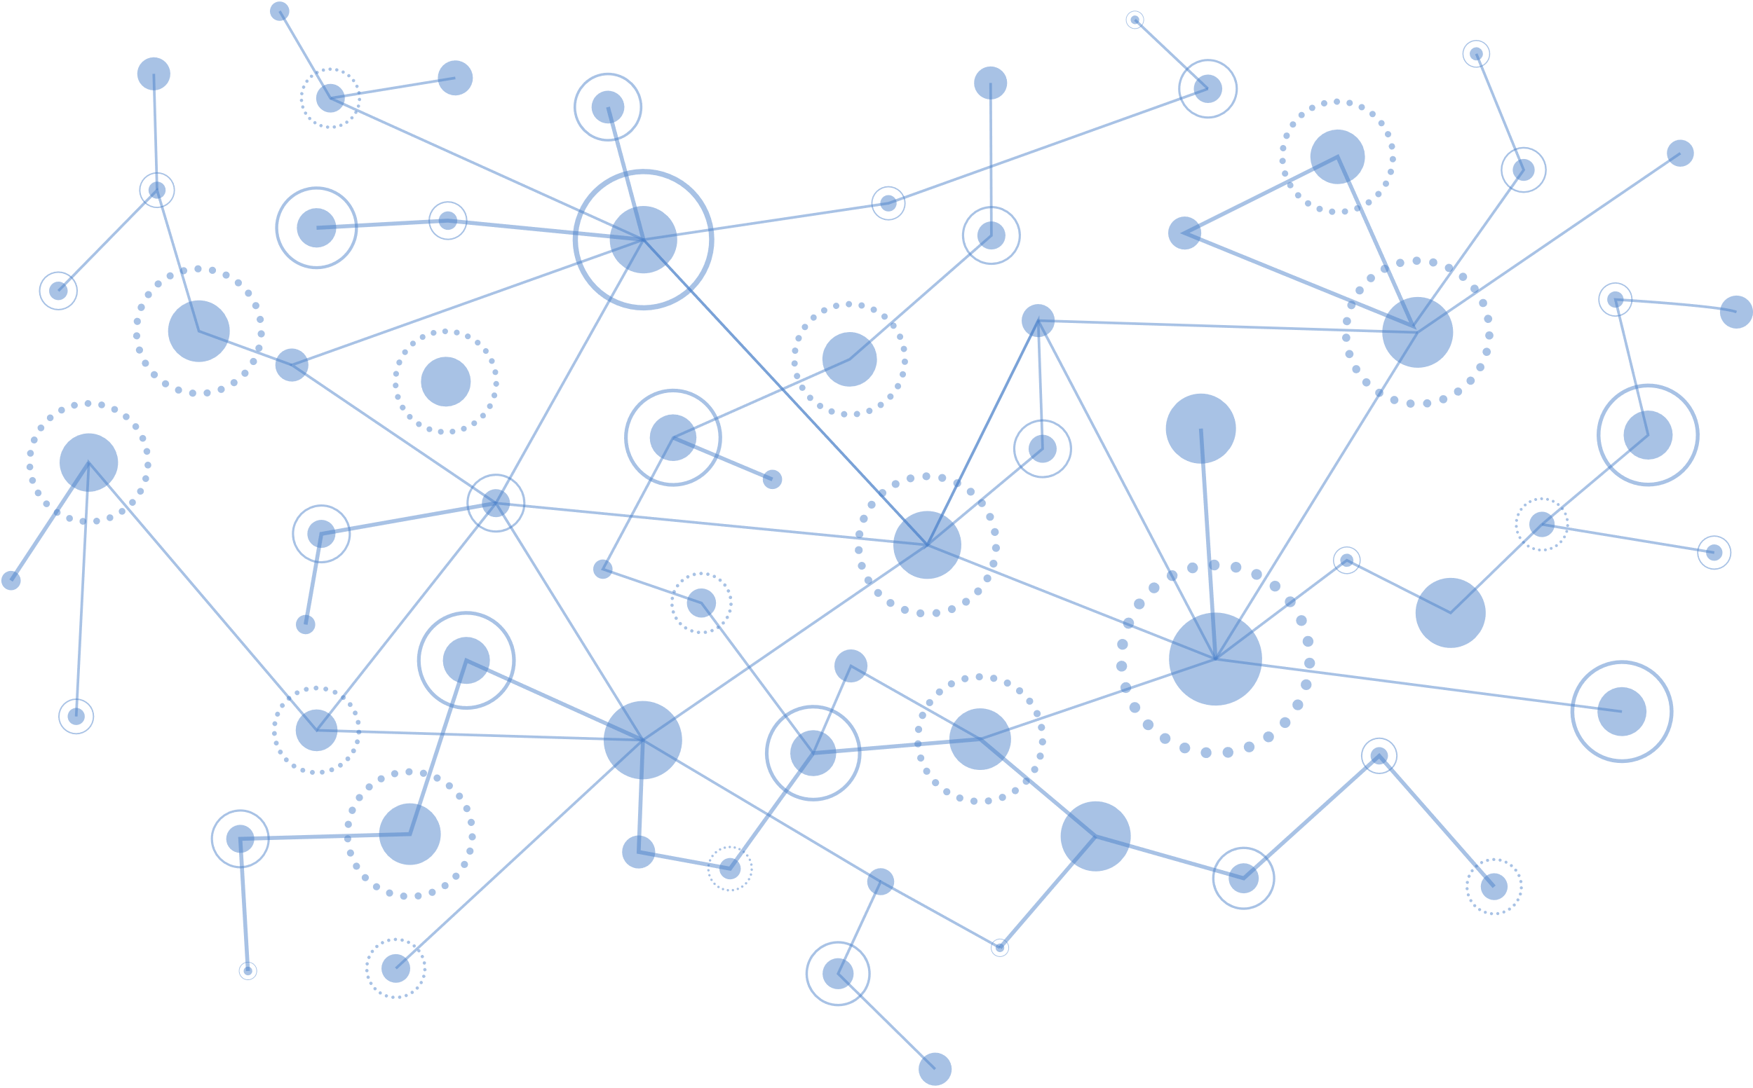
About Us
Tuberculosis
Communicable Disease
Child Development
Food & Facilities
STI
INFORMATICS
Refugee
Violence Prevention
HIV/PreP
Groundwater & Wastewater
Mecklenburg County Public Health Dept.
MCPH located in Charlotte, North Carolina is one of the four departments that make up the Mecklenburg County Health and Human Services Agency.
Has a total population of 1,110,356 residents, MCPH employs 1040 employees (FT/PT).
Protects the health of county residents by providing range of services such as:
Immunizations, HIV/STI Testing and services, and other clinical services
Investigating potential cases of infectious diseases
Conducting restaurant, lodging, and nursing home inspections
Staffing over 150 Charlotte-Mecklenburg Schools with nurses
Pediatric Dental
Public Policy
WIC
Rabies Control
Breast & Cervical
Cancer Screening
Maternal & Child Health
School Health
Community Based Testing
Trauma and Justice
Immunization
Family Planning

Slide 4
Public Policy
Communicable Disease
Rabies Control
Food & Facilities
Community Based Testing
Maternal & Child Health
Refugee
Immunization
Groundwater & Wastewater
Family Planning
WIC
STI
Child Development
INFORMATICS
HIV/PreP
School Health
Tuberculosis
Trauma and Justice
Breast & Cervical
Cancer Screening
Pediatric Dental
Violence Prevention

Slide 5
Public Policy
Communicable Disease
Rabies Control
Food & Facilities
Community Based Testing
Maternal & Child Health
Refugee
Immunization
Groundwater & Wastewater
Family Planning
WIC
STI
INFORMATICS
Child Development
HIV/PreP
School Health
Tuberculosis
Trauma and Justice
Breast & Cervical
Cancer Screening
Pediatric Dental
Violence Prevention

Slide 6
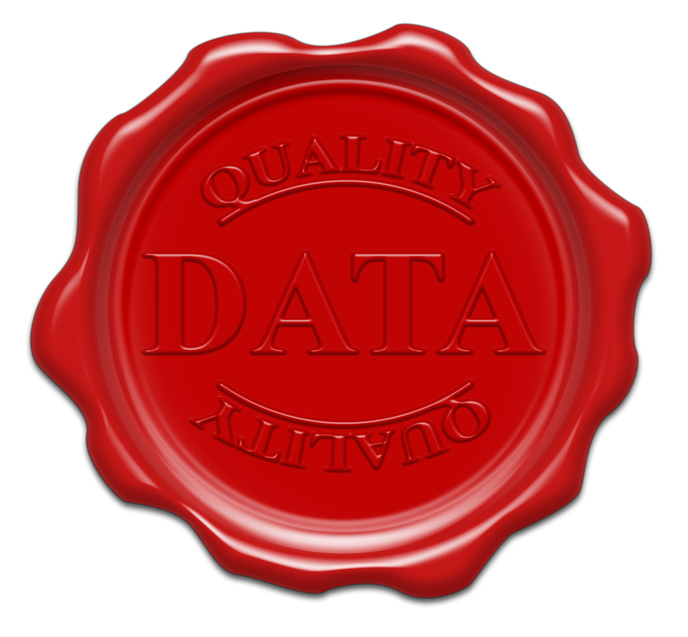
Data Governance Journey
Implementation
Data Inventory
Data Reporting
Structure
& Design
COVID
Precursor to data governance
Understanding what we have and what needs to be controlled
COVID was great learning period for data governance – handling internal data from various sources meshed in with data from state departments and local hospitals

Slide 7
Data Governance Journey
Data Inventory
Data Reporting
Precursor to data governance
Understanding what we have and what needs to be controlled
COVID was great learning period for data governance – handling internal data from various sources meshed in with data from state departments and local hospitals
COVID
Implementation
Structure
& Design

Slide 8
The Importance of High-quality Data In Healthcare
In healthcare, its expected to have the highest quality data...
...because it allows for the best healthcare and service to be provided to patients and clients.
Data Governance Journey
Data Inventory
Data Reporting
Precursor to data governance
Understanding what we have and what needs to be controlled
COVID was great learning period for data governance – handling internal data from various sources meshed in with data from state departments and local hospitals
COVID

Slide 9
The Ugly Truth of Data Quality
Data is often riddled with various issues and concerns like:
31%
of data stewards across programs indicated that there are no established data standards or practices for their respective program.
Duplicate patient profiles
Missing data
Lack of data standardization across data assets

Slide 10
How did we develop and implement a data governance program?

Slide 11
Build a Road Map
Data
Governance
Research
Informational
Sessions
Technical
Infrastructure
Launch data literacy program.
Do not buy technology, assess what you have.
Strategic
Business
Alignment
Research, research, and research.
Program
Brainstorming
Recruitment
Recruit and engage.
What works for other organizations, may not work for you.
Get executive buy-in by introducing DG within your Strategic Business Plan.

Slide 12
Technical Infrastructure
Assess your organization's current technical infrastructure and identify any gaps or limitations that need to be addressed to support effective data governance.
Consider scalability and flexibility of the infrastructure to accommodate future data growth and changing business needs.
Determine the necessary tools and technologies required for data management, data quality, data security, and data integration.

Slide 13
Strategic Business Alignment
Establish a clear understanding of the organization's strategic objectives and how data governance aligns with those goals.
Engage key stakeholders from different business units to gain their support and participation in data governance initiatives.
Identify the critical business processes and systems that generate or consume data and assess the impact of data governance on those processes.

Slide 14
Data Governance Research
Performed extensive program and topic research
Built knowledge of data governance, data quality, data standardization, etc.
Research examples:
Researched data standardization for Public Health data elements
Elements such as: Patient name, Race/Ethnicity, Gender/Gender Identity/Sexual orientation
Collaborated with UNC Charlotte to develop blueprint for data governance/data sharing -> research based
Attended the Data Governance & Information Quality conference
Helpful Session: Getting Started with Data Governance
Attended a variety of webinars
Especially webinars with a focus on initial program development and data literacy i.e Dataversity
Looked into various data governance tools
Started building a data glossary

Slide 15
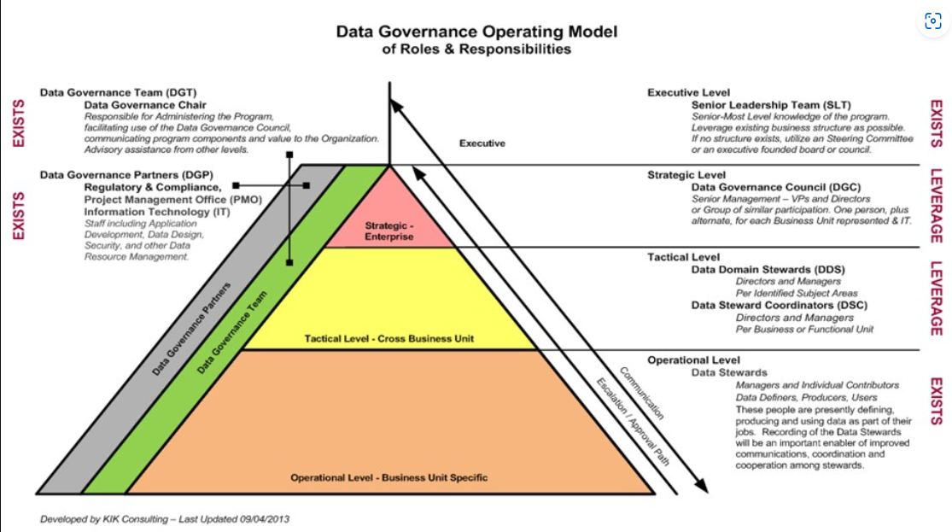
Program Brainstorming
Asked ourselves: How do we develop a data governance program that best fits our organization?
Copyright 2017 DAMA International
Program Structure Reference: Data Governance Operating Model
Developed by KIK Consulting
Provides an elaborate breakdown on all key roles and responsibilities and how communication and work should flow
Program Framework: The DAMA Wheel
Developed by The Data Management Association (DAMA) International
Data management framework that illustrates how different subjects are interconnected
Consists of 11 knowledge areas and highlights how DG is connected to every data management activity

Slide 16
Developing Our Data Governance Structure
Decided to Start Small
Structure will include a governance council and a stewardship program
Reason Behind This Decision
Needed to start with the key players first
Don't have an overwhelming need for all the roles and responsibilities outlined
Advantage of this Approach
Properly dedicate the focus and energy to build out these 2 groups
When/If the need arises, can scale up

Slide 17
How Our Program Groups Work Together
Prioritized the list of issues and concerns
Brainstormed a list of issues and concerns troubling the various programs
Discusses and investigates known issues/concerns
Brainstorms and aligns new/improved data standards, policies, and/or procedures across programs
Reviews proposed recommendations
Works with our policy committee to implement new data standards, policies, and/or procedures
What They Have in Common:
Advocate for and promote data governance efforts
Developing, implementing, and enforcing standardized policies/practices
Participate in data literacy

Slide 18
Hosting Series of Information Sessions
Purpose: Create awareness, establish interest and garner buy-in from all levels of leadership and staffing
Approach:
Upper leadership -> Middle managers -> Staff
Audience-based session materials:
Overview of data governance
Reasoning for pursuing to est. data governance
Relevant examples of how data governance relates to programs
Hands-on activity to better understand governance activities

Slide 19
Program Recruitment
Clearly identify roles and responsibilities
Provide transparency in terms of time commitment, work to be done, etc.
Develop job descriptions and criteria for each role *optional*
Outline necessary skills, qualifications, and experience
Define the recruitment process
List out the steps and provide details in terms of how to apply/indicate interest in group membership to notification of acceptance
Provide training and on-boarding
Group specific training to teach or familiarize individual to the organization’s data governance framework and processes
Offer extra educational materials geared towards training topics

Slide 20
Build a Road Map
Data
Governance
Research
Informational
Sessions
Technical
Infrastructure
Launch data literacy program.
Do not buy technology, assess what you have.
Strategic
Business
Alignment
Research, research, and research.
Program
Brainstorming
Recruitment
Recruit and engage.
What works for other organizations, may not work for you.
Get executive buy-in by introducing DG within your Strategic Business Plan.

Slide 21
How to introduce a data quality in the early stages of a data governance program?

Slide 22
Align with Strategic Business Plan
Develop Partnerships
Establish Data Literacy Pathway

Slide 23
Align with Strategic Business Plan
Develop Partnerships
Establish Data Literacy Pathway
Introduce and identify key business objectives and metrics that are critical to the success of the organization. Focus on the most important data and business needs.
This can include automated validation checks, as well as manual review and approval of processes to ensure that data is accurate and consistent.

Slide 24
Develop Partnerships
Establish Data Literacy Pathway
Align with Strategic Business Plan
Partnership with the academia and industry experts
Access to expert knowledge and resources; research and development opportunities; and enhanced reputation and visibility.
The academe are usually the forefront of innovation and fresh perspectives – drive innovation and creativity.
Partnerships with programs across Public Health

Slide 25
Establish Data Literacy Pathway
Align with Strategic Business Plan
Develop Partnerships
Data Crunch series – ongoing training to enhance and excite organization staff at all levels on data (analysis, quality, and governance)
Education of stakeholders across the organization about the importance of data quality

Slide 26
Align with Strategic Business Plan
Develop Partnerships
Establish Data Literacy Pathway

Slide 27
How to establish standards to improve data veracity and reliability?
Standardization =
Quality
Trustworthy data
Informed Decision Making
Improved Data Sharing
Collaboration
Integration
Enhanced Privacy, Security

Slide 28
Discovery + Prioritization
Discussion + Research
Alignment + Discussion
Buy-in + Adoption
Standardization =
Quality
Trustworthy data
Informed Decision Making
Improved Data Sharing
Collaboration
Integration
Enhanced Privacy, Security

Slide 29
MCPH Framework for Establishing Standards
Discovery + Prioritization
Discussion + Research
Alignment + Discussion
Buy-in + Adoption

Slide 30
Discovery + Prioritization
Perform initial research and exploration of standards and policies for your line of business
Brainstorm a list of data issues and concerns plaguing the various teams and programs
Have concerns broken up by category
Ex. data collection, data storage, data analysis and reporting
To be performed by the Stewardship program and/or the Governance Council
Review and summarize the list as needed
With the list, have the Governance Council assign a priority level for each item on the list
Once completed, the list should be provided to the stewardship program to start working to address

Slide 31
Discussion + Research
Provide background reading and resources to prepare stewards for future discussion regarding the issue
Ensures adequate time to think and learn more about topic
Helps establish the tone for the meeting and ensure proper background knowledge
Survey stewards prior to meeting to gather insight to the topic and issue being addressed
Allows time to review current work across programs and enables you to provide a high overview summary to stewards to keep in mind during the meeting discussion
Present first issue for discussion to the Stewardship program and open the floor for discussion
Some individuals to think individually and discuss with small groups - some individuals think best when provided time to first gather their own thoughts
Ex. Patient demographics
Delegate responsibilities to stewards to research standards in respective areas

Slide 32
Alignment + Discussion
After initial discussion, ask stewards to recommend their best suggestion for all team/programs to ask/collect/store the selected topic of data
Ex. Patient demographics
How is gender being asked/collected?
Gender at birth vs gender identity vs sexual orientation
How is gender being inputted/stored in various programs
Have stewards discuss how to best align their recommendations across the entire division

Slide 33
Buy-in + Adoption
Pass the proposed recommendation(s) to the Governance Council for review
Option 1: Adopt -> Send the proposed data standard to the Policy committee to review and make final determination on adoption from all Public Health program perspectives
Council will work with the Policy committee to develop recommendation into a policy
Option 2: Return recommendations to Stewardship Group -> Council will suggest areas for revisions and/or request additional research and discussion to flesh out ideas
Ensures formal and informal buy-in across various stakeholders
Makes sure everyone is properly informed of goal, work of the data gov program, what to expect going forward
Buy-in Examples:
Presentations to various levels of leadership, programs and project teams
Intent forms
Lunch & learns

Slide 34
Overcome data governance implementation roadblocks through data literacy.

Slide 35
Data Literacy is a Journey

Slide 36
Data Literacy is an actual Journey

Slide 37
Data Literacy Journey
Understand the Why
Create Desire for Change
Engage People

Slide 38
Utilize the ADKAR Model
Awareness, Desire, Knowledge, Ability, and Reinforcement
Model promotes employee engagement and increases the likelihood of successful change adoption
Understand the why
Set clear vision of data governance from all levels of the organization
Creating awareness of the need for change, ensures everyone understands the reasons behind it
Create Desire for Change
Understand the Why
Engage People

Slide 39
Acknowledge the expertise on data from staff
Understand the benefits and positive outcomes of this process
Address concerns or resistances regarding the process
Fear is typically associated with the change
Understand the Why
Create Desire for Change
Engage People

Slide 40
Provide necessary knowledge and information about the process
Develop the skills and abilities
Ongoing support, recognition and reward to sustain new behaviors for long-term adoption
Data Literacy Program
Varying levels (ranges from 101 for Front Line Staff to 301 for Epidemiology team)
Academic Partnership
Data Crunch Series (lunch and learn)
Understand the Why
Engage People
Create Desire for Change

Slide 41
Data Literacy Pathway
Utilize the ADKAR Model
Awareness, Desire, Knowledge, Ability, and Reinforcement (Monitor)
Understand the why
Set clear vision of data governance from all levels of the organization
Acknowledge the expertise on data from staff
Address the change
Data governance requires a high level of data literacy among employees
Create educational opportunities to empower staff
Engage People

Slide 42
Tools for Data Governance

Slide 43
Tools for Data Governance
People are your primary tools
Data Integration Tools – capture data from various sources
Data Quality Tools – assessing and improving quality of data
Data Cataloging Tool – creates inventory of data sources
Data Security and Access Control – enforcing data security policy
Master Data Management (MDM) – consistency and accuracy of critical data entities
Metadata Management – capturing and documenting information about your data, relationships and structure
People are your primary tools

Slide 44
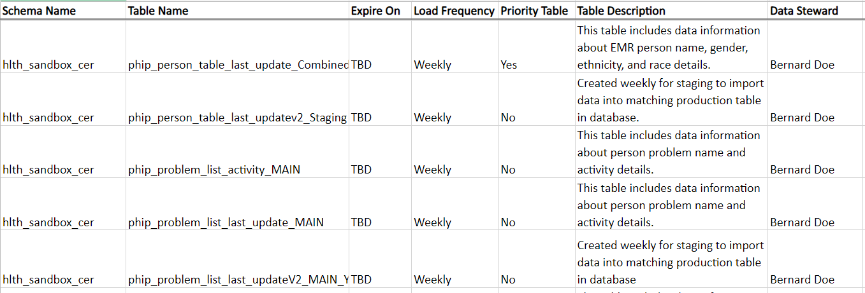
Data Dictionary Example

Slide 45
Recommendations to Jumpstart Your Data Governance Program

Slide 46
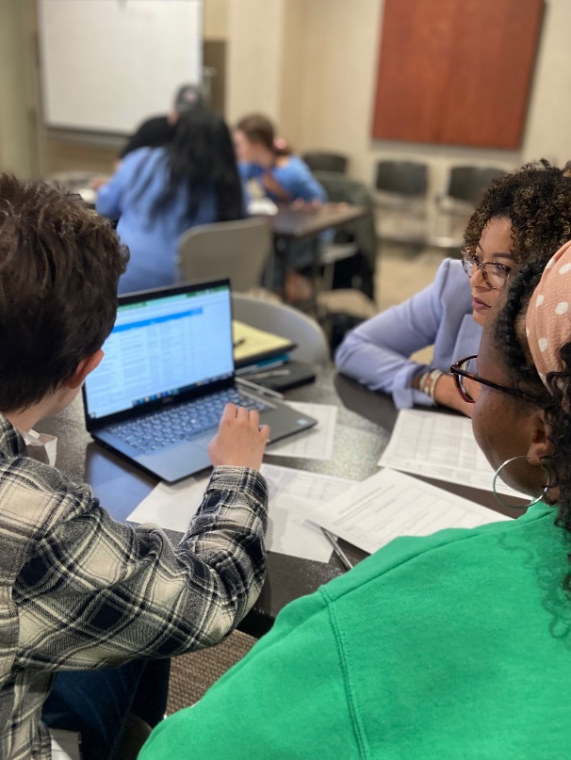
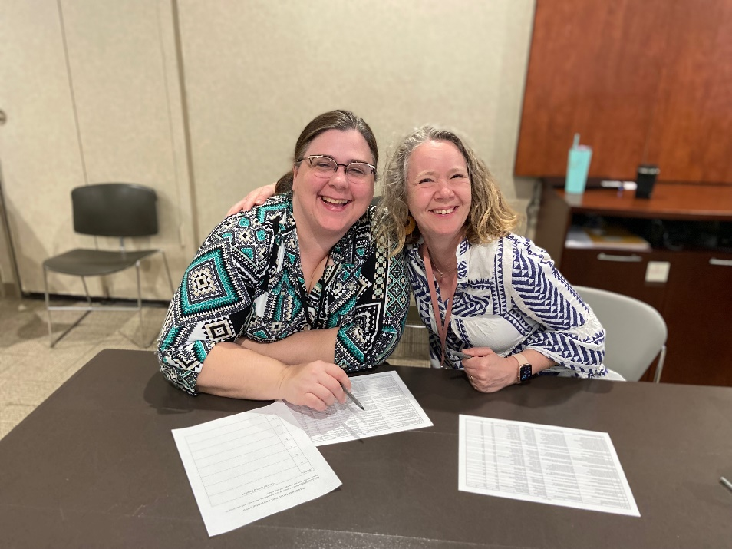
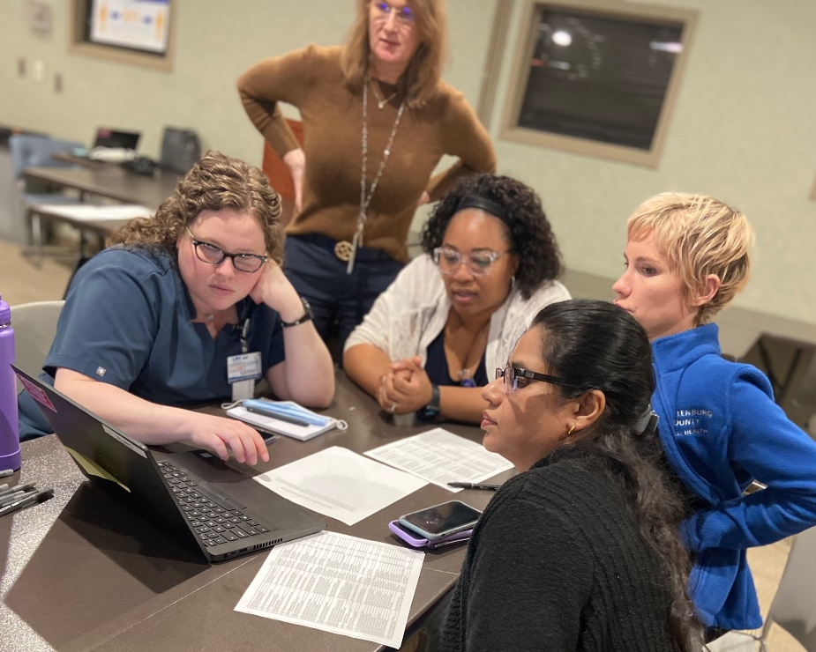
Recommendations to Jumpstart Your Data Governance Program
Make Sure: Data Governance is aligned and defined in your SBP
Do Your Research -> Ask yourself: What is applicable to your organization?
Acquire the foundational knowledge on:
DAMA, Industry standards, best practices, etc.
Determine framework that will best serve you to establish and maintain data governance
Establishing a Data Literacy Pathway
Educating staff on data governance
Build and Foster Your Community
Data Stewardship + Data Governance Council
Don’t focus on buying technology solutions with the mindset of “It will govern itself”

Slide 47
In summary…
At the end of day, data governance followed the Public Health Informatics guideline of "understanding and aligning people, processes, policies, and data to produce useful information"
You can have all the latest and most popular tools, software, technologies, etc. but unless you create an environment where people feel comfortable and safe to speak, you can't expect your data governance program to be successful

Slide 48
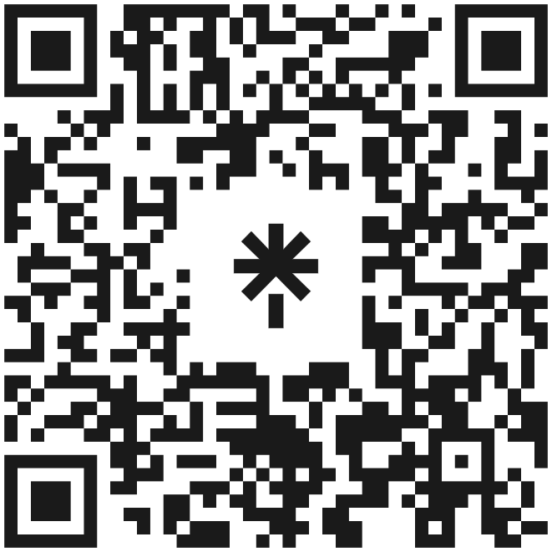
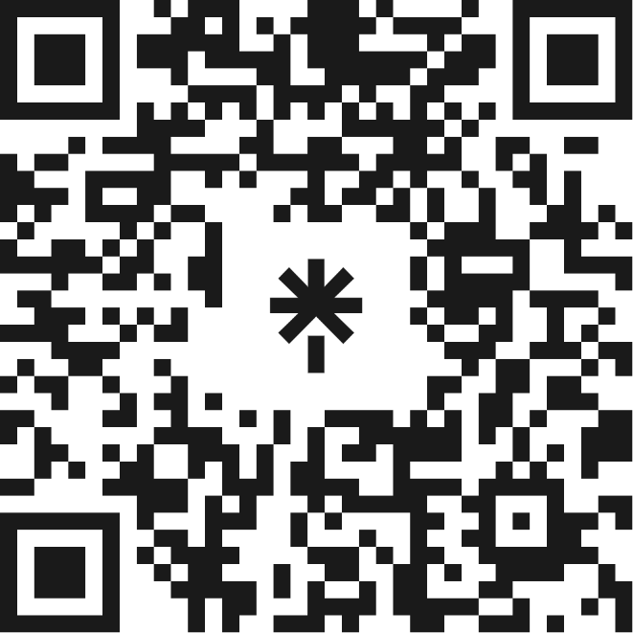
Thank you! Questions & Answers
Let’s connect
Jonathan Ong Lauren Cook

Slide 49
Mentioned Resources
United States Core Data for Interoperability (USCDI)
USCDI V4
A standardized set of health data classes and elements.
USCDI+
A public health domain specific data element list created with federal and industry partners
ONC is currently updating the list and will be released later in 2023.
American Health Information Management Association (AHIMA)
Naming Policy
Resource utilized to better understand how to capture and record patient information.

