Slide 1
Special meeting on COVID lessons learned so far
This meeting will begin at 2:00 pm ET.
Notes:
The Local Health IT CoP was spurred from a member's desire to connect with other IT staff at health departments around the country.
The community is run by members of the NACCHO IT Team.

Slide 2
Local Health IT CoP
Agenda
August 26, 2021
Harris County: Creation of an emergency response system (15 mins)
Sedgwick County: Lessons learned from their county (15 mins)
Orange County: Creation FL Region 5 IT Consortium (7 mins)
Rural and Frontier Department Project: Promoting testing, tracing, and vaccine uptake (7 mins)
Open discussion on COVID Lessons Learned (15-30 mins)
Notes:
Our agenda for today. We have Roger Grimes of KnowBe4 with us. Roger will be presenting on the many ways to hack multifactor authentication. We will leave some time at the end for discussion on this topic as well as some time to chat as a group on experiences or challenges that you would like to share.

Slide 3
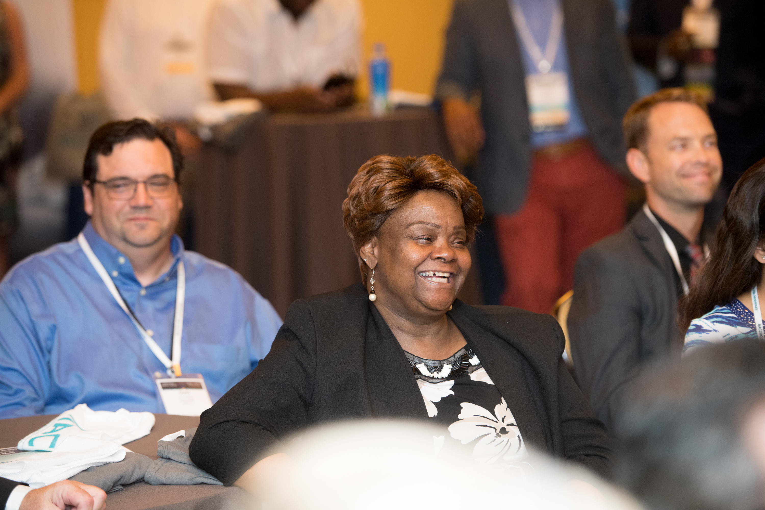
Local Health IT CoP
The Local Health IT CoP was created from a member's need to connect IT departments at health departments around the country.
It's run by the NACCHO IT Team.
We meet when there is a need to share timely information.
For more information, visit: https://www.naccho.org/lhit

Slide 8
Simply send an email to: Naccho-lhit@connectedcommunity.org
Create a LHIT Community Discussion Post Via Email!

Slide 10
Harris County
2021 Model Practice Winner
Speakers
Cristina Etchells, Business & Information Support Manager
Michael Schaffer, Director of Environmental Public Health

Slide 15
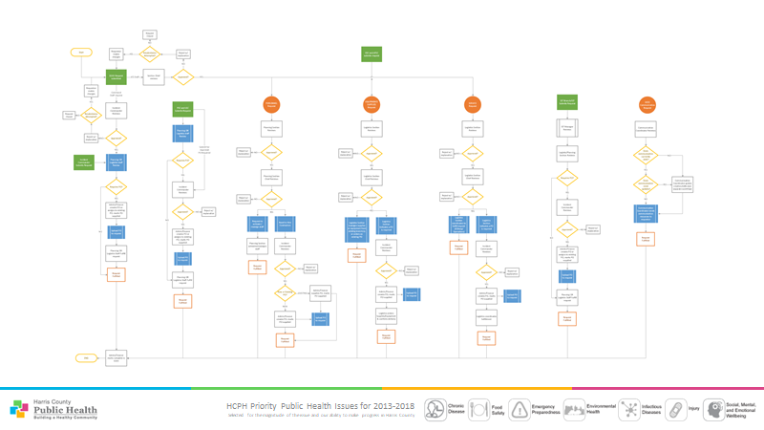

Slide 17
Harris County
Questions or comments for Harris County?
Speakers
Cristina Etchells, Business & Information Support Manager
Michael Schaffer, Director of Environmental Public Health

Slide 18
Sedgwick County
Speaker
Sonya Norris, Public Health Systems Analyst at Sedgwick County Health Department in Wichita Kansas
Previously presented on her EHR project with data distribution
Lessons learned from the technology department

Slide 19
Sedgwick County
Questions for Sonya or her team?
Sonya Norris, Public Health Systems Analyst at Sedgwick County Health Department in Wichita Kansas

Slide 20
Orange County
Questions for Sonya or her team?
Sonya Norris, Public Health Systems Analyst at Sedgwick County Health Department in Wichita Kansas

Slide 29
Rural and Frontier Department Project
Speaker
Dave Reddick, Chief Strategy Officer and Co-Founder of Bio-Defense Network

Slide 38
Rural and Frontier Department Project
Questions?
Dave Reddick, Chief Strategy Officer and Co-Founder of Bio-Defense Network

Slide 39
Discussion
Questions?
What are your lessons learned from the pandemic so far that can help other local health departments in their planning efforts?
Notes:
Discussion

Slide 40
Your Stories
Questions from the Community
From HHS ASPR: One of the challenges that we are struggling with is around measuring the impact to patient care from Cyber incidents. It would be great to hear from the participants about any methodologies or processes that they use in their healthcare facilities to assess the impact in advance of developing remediation steps.
- Bob Bastani, HHS ASPR
Notes:
Would anyone like to give some examples of how you are currently approaching data governance, best practices or lessons learned?

Slide 41
Accessing Virtual Communities
Start a discussion thread by emailing
NACCHO-lhit@ConnectedCommunity.org
Manage your community notification settings
Manage Community Subscriptions
Notes:
We also know that you are all busy folks, so we wanted to make sure that each of you are aware that in addition to interacting with the community via the virtual communities site, you can also always start a discussion in the community by simply emailing to NACCHO-LHIT@connectedcommunity.org
You can also manage your community subscriptions within your community profile, to allow for real-time messages or daily digests. Real-time subscription would provide you with a direct real time email anytime a new post is made in the community. While daily digest will provide you with a consolidated update each morning, on posts made during the previous day. If you need any assistance with this, feel free to reach out to our team.

Slide 42
Next Meeting
What would be the most helpful for you right now?
Do you have something you could share with the group?
Can we connect you to experts or tools?
Notes:
Our next meeting is scheduled for July 20th, from 1-2PM ET. Please let us know if there is any topic, expert or tool that you can think of that would be helpful for you to learn about right now. Also, if you have an experience that you think the rest of the group could learn from or help with, we’d love to hear about it the work you all are doing within your departments.

Slide 43
Questions or Comments
Any questions or comments about this CoP?
You may reach out to our team via Web@naccho.org.
Please feel free to continue the discussion by posting in the Local Health IT virtual community!
Notes:
Any questions or comments about this CoP?
You may reach out to our team via Web@naccho.org.
Please feel free to continue the discussion by posting in the Local Health IT virtual community!
Presentation recording and slides will be posted to the community shortly.
We hope you can all join us in July

