Slide 1
Undergoing Digital Transformation in Public Health
amidst a Pandemic

Slide 2
Today’s Discussion is around our EHR Implementation
Well Done?
Missed Opportunities?

Slide 3
What we did well
Created Team as Expert with the right RR&Es
Adjusted to the daily changes of major tasks affecting deliverables
Thought outside the box on vendor dependent tasks
Implemented multiple leveraged business applications to assist

Slide 4
RR&E (Role, Responsibilities and Expectations) = EHR Implementation Team
Implementation Leader
Implementation Support Analyst
Data Specialist
2 Application Specialist
Project Manager
Training Coordinator
Process and Workflow Coordinator

Slide 5
Responding to Rapid Changes
Dependencies:
News stories and media perceptions
Perceptions of Sedgwick County citizens
Perception of County Managers and Public Health Leaders
Adoption of the Workforce

Slide 6
Thinking outside the box
Hosted the “Make the Connection” Hackathon with EHR Vendor and KDHE

Slide 7
Other Digital Transformations
Other Implementations include
Monday.com
Implemented the QLess application to assist with
Consumer Scheduling plugin to EHR
Vaccine Inventory System (Accuvax)

Slide 8
Lessons Learned
Clarity
Leadership
Criticality
Stakeholder Engagement

Slide 9
Abandoned…until further notice

Slide 10
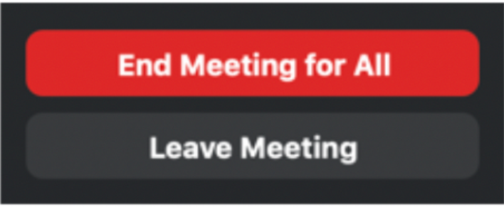
Leadership leave meetings without having consulted I.T.
…and the entire meeting was about installing a process or solution that has everything to do with I.T.

Slide 11
Critical Missed Opportunity = Athena and Billing
Assumptions about automated billing
What are the gaps?
What do staff need to know?

Slide 12
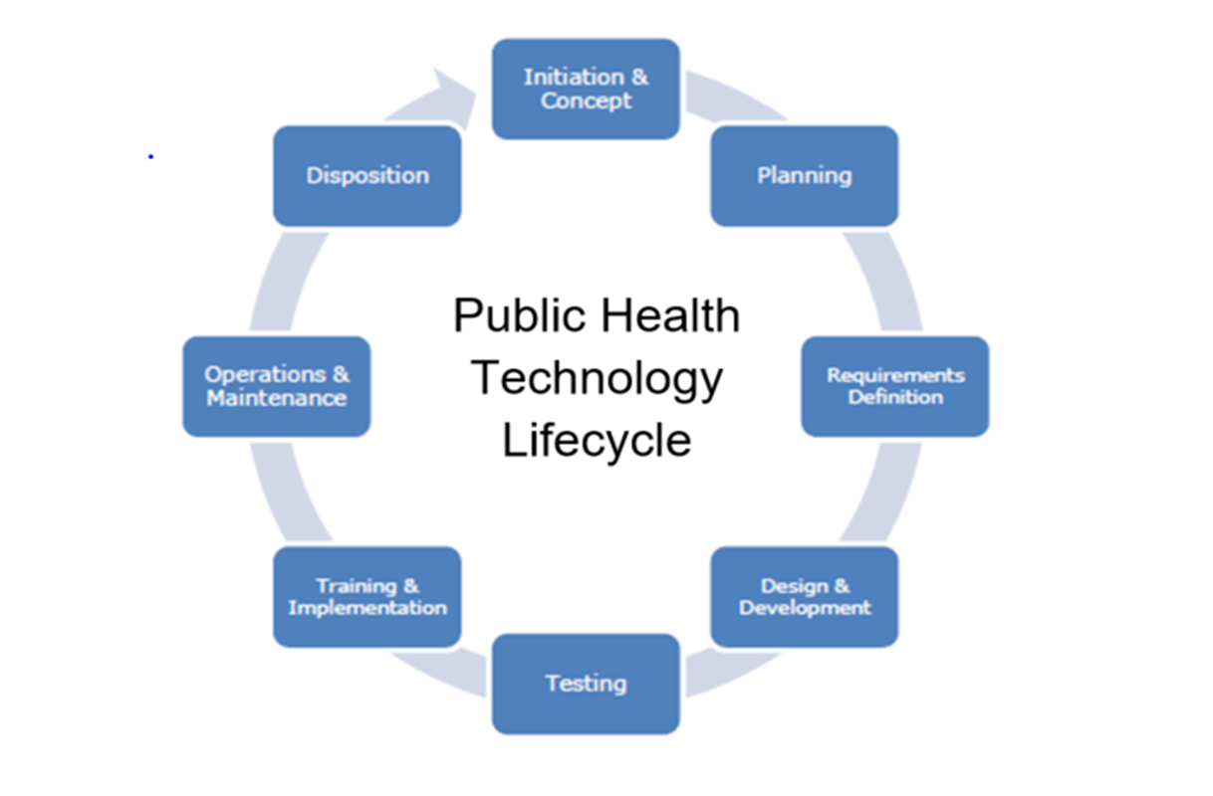
Exit Criteria and Accountability from a board of representatives

Slide 13
Thank you so much
All the best,
Sonya V. Norris, public health systems analyst

