Slide 1
This meeting will begin at 2pm ET.

Slide 2
Local Health IT CoP
Agenda
August 11, 2020
Introductions and Discussion: What have you learned during COVID?
Member: Lessons from Jefferson McMillan-Wilhoit from Lake County
Discussion: What can we learn from each other to better leverage data? What are other lessons from NACCHO Annual?
Your Stories: What are some of your biggest challenges / successes in moving to a remote workforce? Are there other issues you'd like to discuss with the group?
Other opportunities

Slide 3
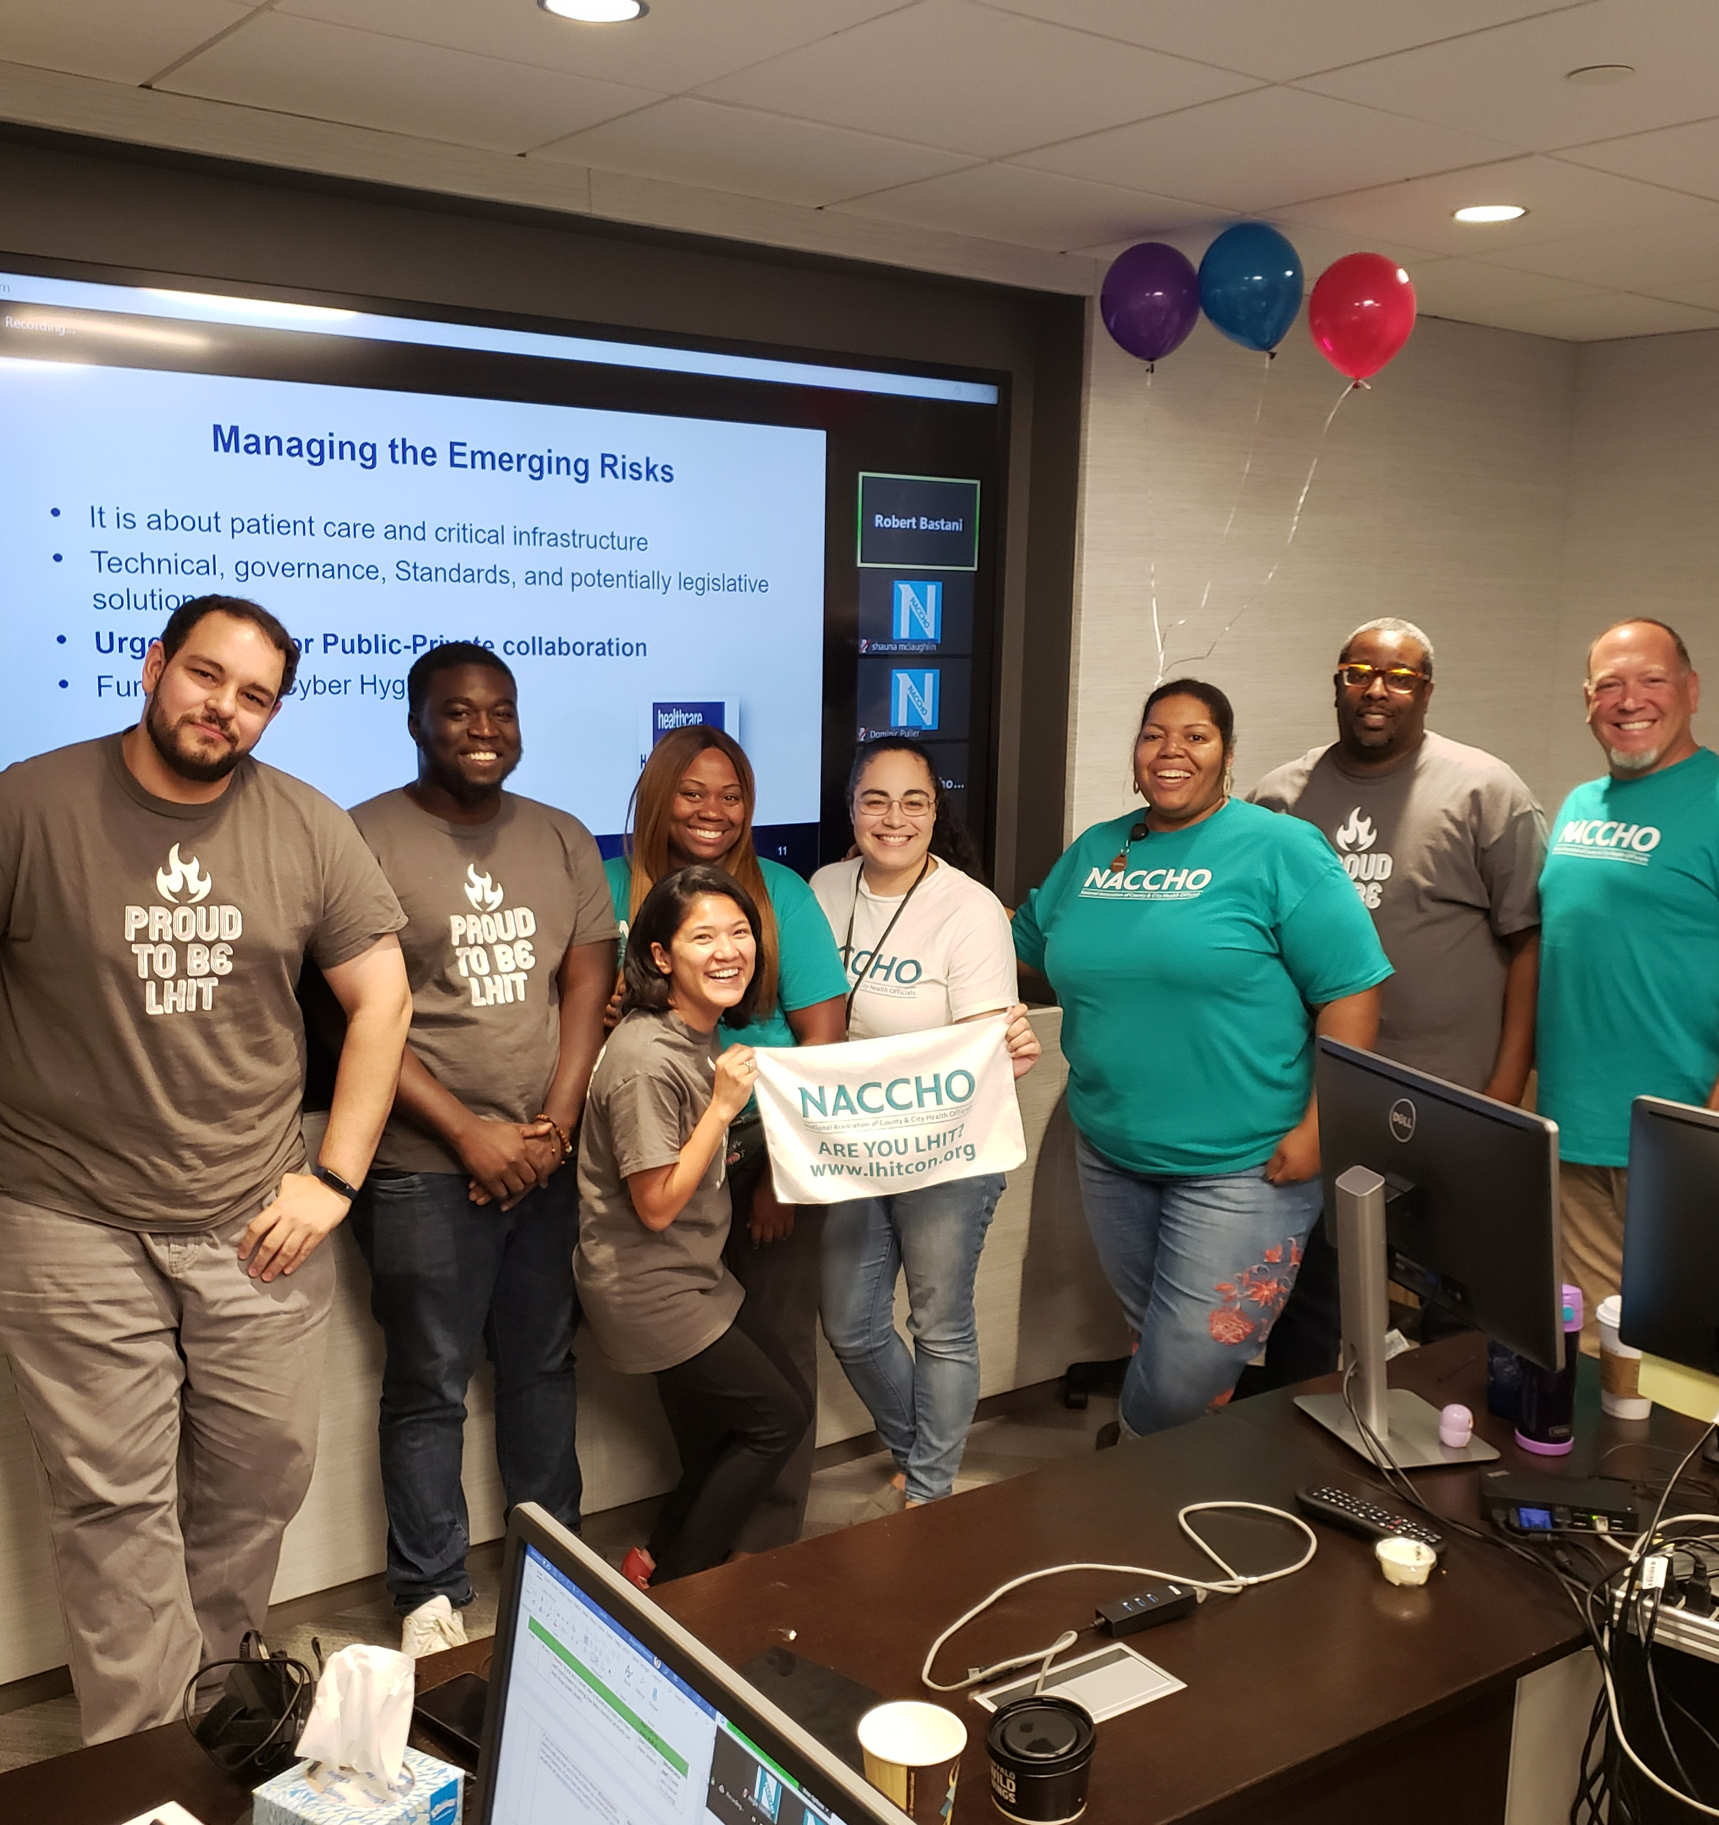
Introductions
Name
Local Health Department
[First-timers] What would you like to learn from this group?
[Returning members] What has your LHD learned since the start of COVID that other LHDS can learn from?

Slide 4
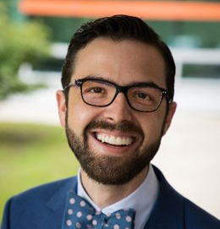
Member Story
Jefferson McMillan-Wilhoit
Director for Health Informatics and Technology
Lake County Health Department and Community Health Center in Lake County, IL
Jefferson has spent his career using data to help improve the state of his community. He uses data to help with strategic decision making.

Slide 13
Discussion
How many of you are using ESRI or have a team using ESRI?
What can we learn from each other to better leverage data?
What are other lessons from NACCHO Annual?

Slide 14
Your Stories
Questions from the Community
"What are some of your biggest challenges / successes in moving to a remote workforce?"
What did you experience while making the move to remote? Did your LHD stay onsite?

Slide 15
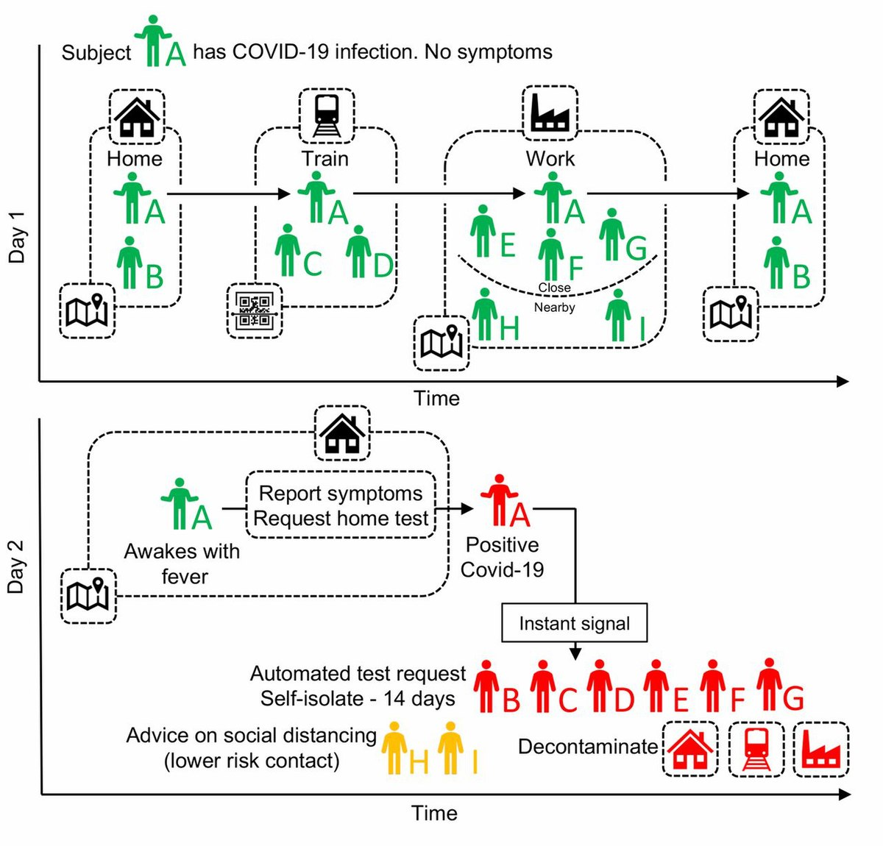
Your Stories
Questions from the Community
"What successes have agencies found with Contact Tracing and using technology to make it successful. Currently, our staff calls people and uses pen and paper to capture results. I am assuming someone found a better way. 😊"

Slide 16
Recent News
From NPR Morning Edition: https://www.npr.org/2020/08/11/901219090/californias-public-health-director-abruptly-leaves-her-position
"The fact that we’re still faxing pieces of paper left, right, and center. And we literally have health departments where the fax machines can’t keep up with the reports that are coming in [...] And the fact that the CDC has been neutered and disappeared." - Dr. Arthur Reingold, UC Berkeley School of Public Health

Slide 17
Recent News
Chris Collinge interviewed for "Leading During Crisis": https://www.youtube.com/watch?v=4_sne72Zv9c&feature=youtu.be

Slide 18
Preparedness Summit 2020
Taking place August 25-27
There will be a track for Enhancing Public Health, Healthcare, and Emergency Management Systems

Slide 19
Next Meeting
We don't meet just to meet.
What will be the most helpful for you right now?
Can we connect you to experts or tools?

Slide 20
Questions or Comments
Any questions or comments about this CoP?
Any overall website feedback, etc?
All additional comments and questions can be sent to amcpherson@naccho.org.

