Slide 1
Community Meeting: Wednesday, August 23, 2023
This presentation will begin at 1 pm ET.

Slide 2
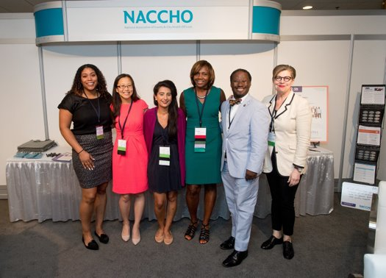
NACCHO's Mission ​
The National Association of County & City Health Officials (NACCHO) is comprised of nearly 3,000 local health departments across the United States.
Our mission is to serve as a leader, partner, catalyst, and voice for local health departments.

Slide 3
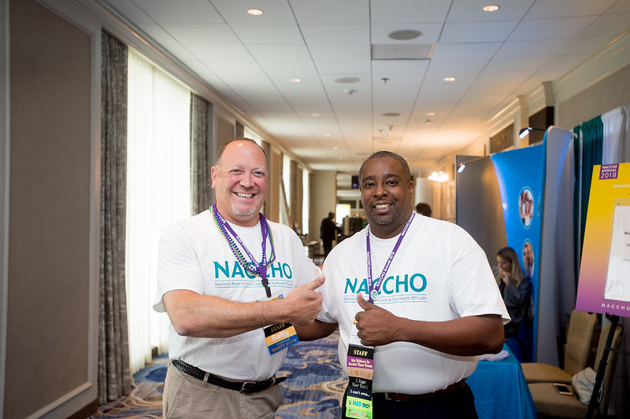
Local Health IT CoP
The Local Health IT CoP was created from a member's need to connect IT departments at health departments around the country.
It's run by the NACCHO IT Team.
We meet when there is a need to share timely information.
For more information, visit: https://www.naccho.org/lhit

Slide 4
Today's Meeting
New Member Shout Out
Lessons Learned from NACCHO 360 – Jason Frame, Chief Information Officer, Southern Nevada Health District
Quarterly Retrospective

Slide 5
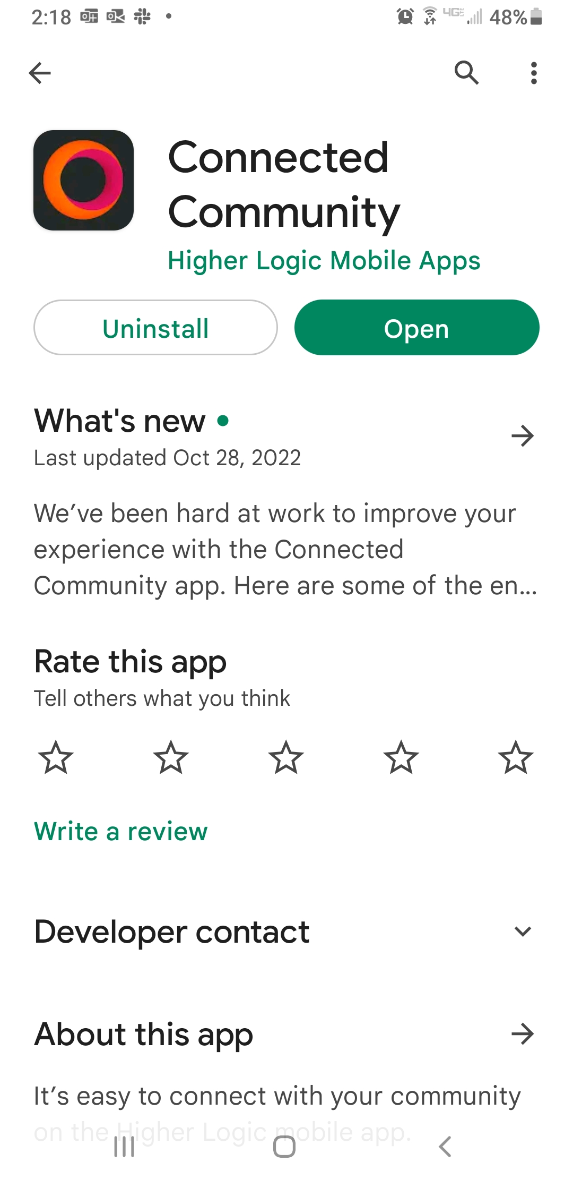
Stay Connected
Download Connected Communities
Login: virtualcommunities.naccho.org
Your MyNACCHO login
Ba-da-bing ba-da-boom

Slide 6
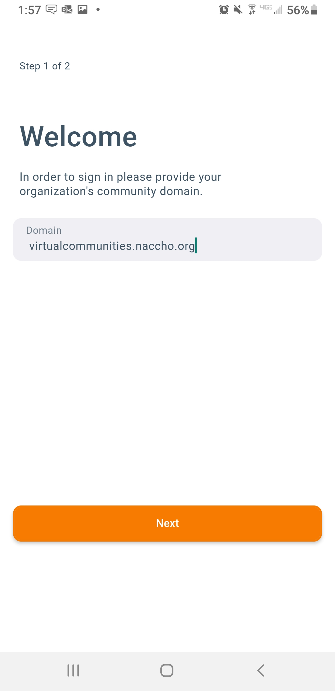
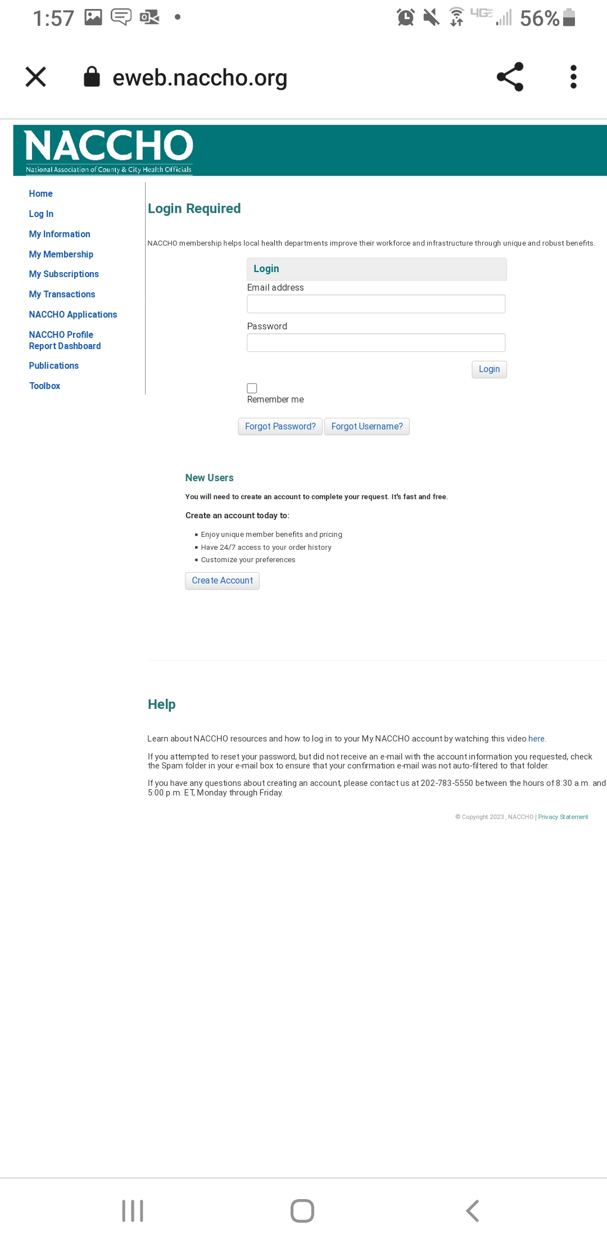
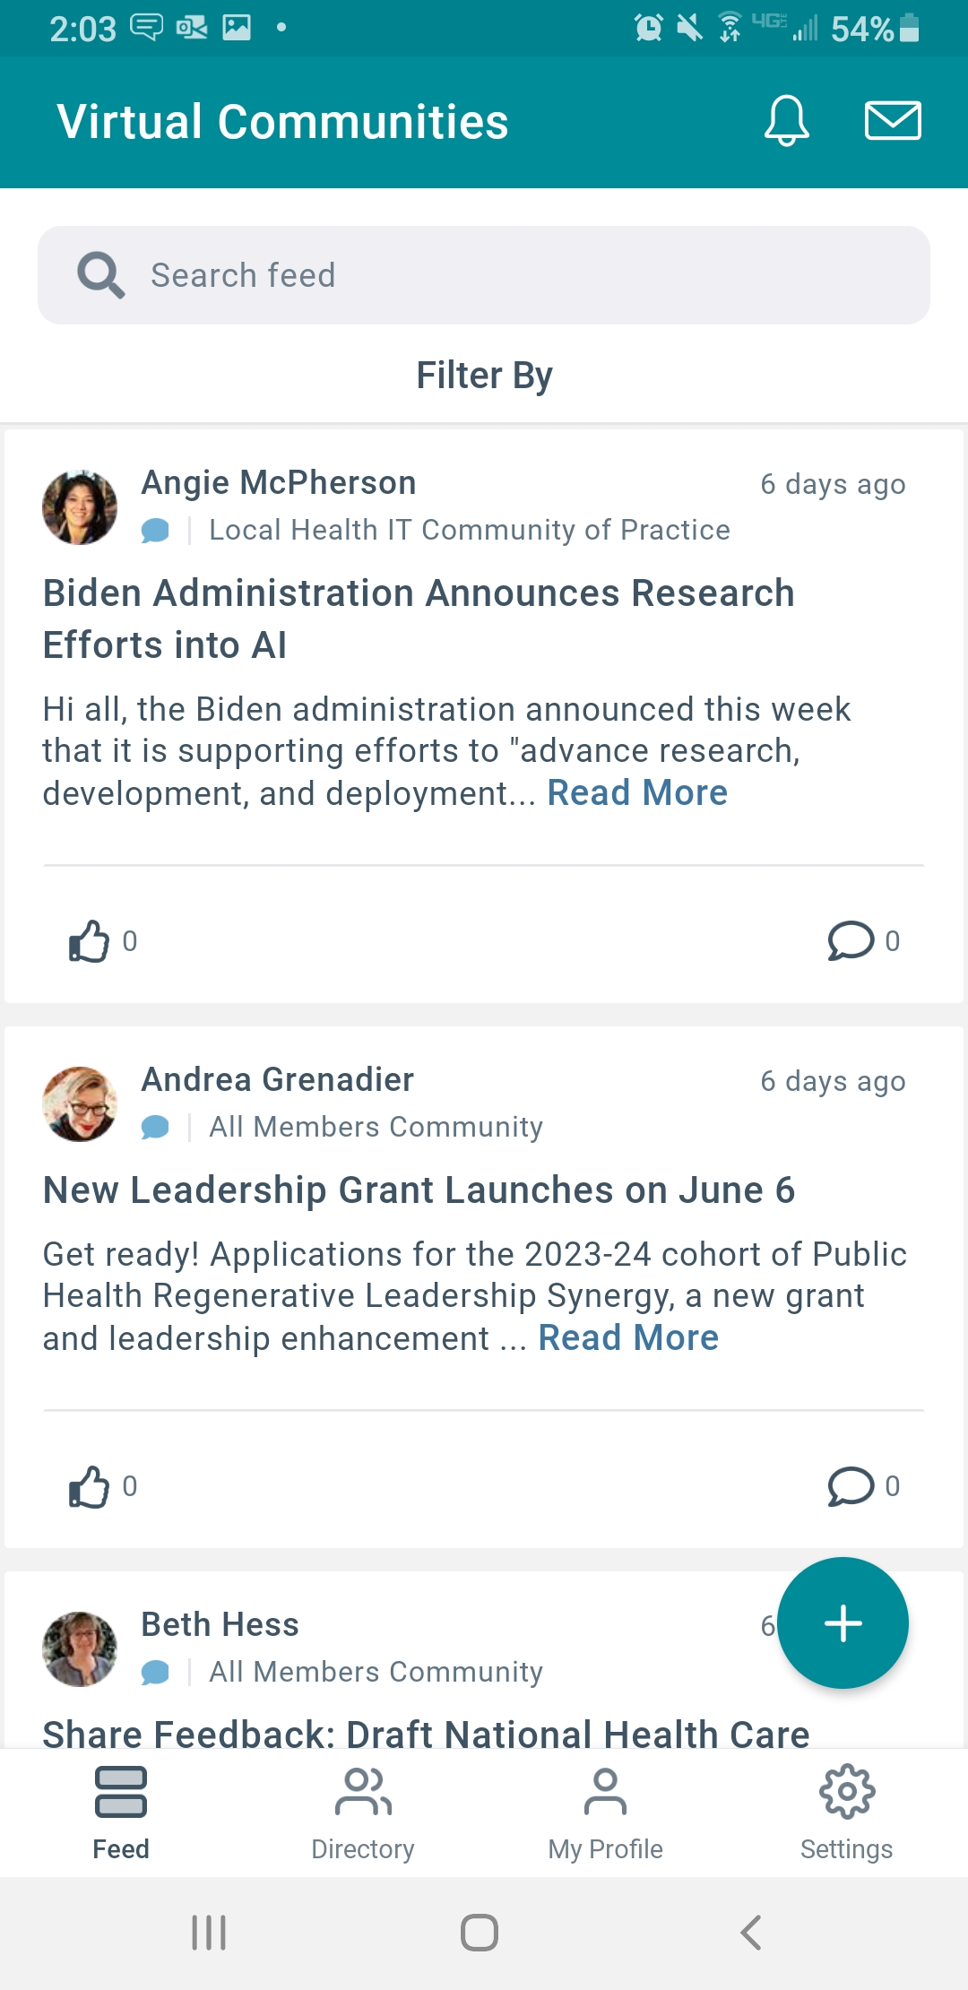

Slide 7
New Members
Introduce yourself
What's at the top of your mind
Elaborate on specific projects: Ones we should know about and how we can work together
If you're new, what would you like to learn about?

Slide 8
Takeaways from NACCHO 360
Everyone is talking about IT
Everyone has a cybersecurity story, it's important to connect LHDs
Programs do better when they recognize and work with IT instead of seeing it as an aside
Local Health Officials are often afraid to talk about IT, but want to communicate needs
Want to try to do sprint retrospectives for our meetings
We need more LHIT members in the room at NACCHO 360
Jason Frame Chief Information Technology
Southern Nevada

Slide 9
Discussion
Are there other takeaways from conferences you've attended this year?
At DefCon, we learned the White House is fast tracking an executive order on AI
At Ai4, we learned that a local health department in Canada used IBM Watson Assistant to power a virtual assistant
Notes:
Local health departments are the backbone of the public health system in the United States. As a leader, partner, catalyst, and voice for LHDs, NACCHO advances the work of local health officials and their staffs to create healthy, thriving communities.

Slide 10
Quarterly Retrospective
What are your insights from this quarter?
What are you working right now?
What went well?
What could've done better?
How can we help you right now?
Retrospective Doc
Notes:
Local health departments are the backbone of the public health system in the United States. As a leader, partner, catalyst, and voice for LHDs, NACCHO advances the work of local health officials and their staffs to create healthy, thriving communities.

Slide 11
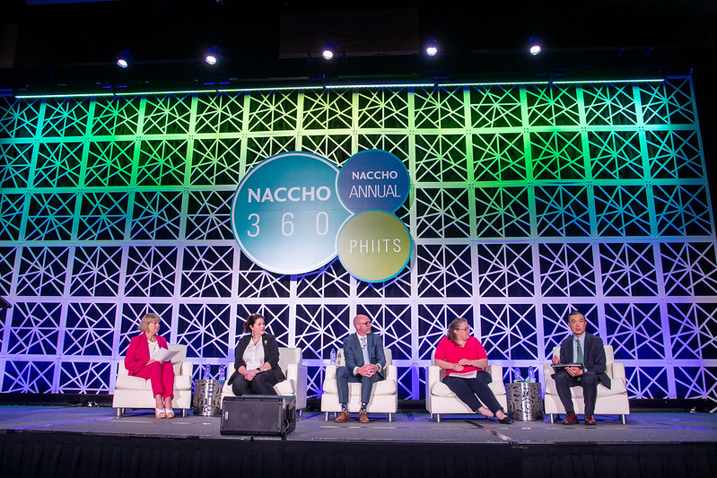
Upcoming Events
August 31 at 2pm: Data Governance with Jonathan Ong
September 7 and 8: Healthcare Cybersecurity Forum, Boston
September 19: IT Modernization Summit 2023
December 14 and 15: ONC 2023 Annual Meeting
Notes:
Local health departments are the backbone of the public health system in the United States. As a leader, partner, catalyst, and voice for LHDs, NACCHO advances the work of local health officials and their staffs to create healthy, thriving communities.

Slide 12
Last Thoughts
What are your thoughts after the presentations?
Is there anything that you'd like to discuss with the group now?
What information from today has been the most helpful for you?
Are there other projects we can highlight?
Notes:
Local health departments are the backbone of the public health system in the United States. As a leader, partner, catalyst, and voice for LHDs, NACCHO advances the work of local health officials and their staffs to create healthy, thriving communities.

Slide 13
Virtual Communities
Visit https://virtualcommunities.naccho.org/
Select how you want to receive email communication
Can also email NACCHO-lhit@ConnectedCommunity.org

Slide 16
Next Meeting
We can discuss YOUR PROJECTS
Possible topic: Returning to the office
Is there something we need to meet about?
Bring a friend

Slide 17
Thank you to our presenters!
Notes:
Local health departments are the backbone of the public health system in the United States. As a leader, partner, catalyst, and voice for LHDs, NACCHO advances the work of local health officials and their staffs to create healthy, thriving communities.

Slide 18
Questions or Comments
Any questions or comments about this CoP? Any overall website feedback, etc.? Visit www.naccho.org/lhit to learn more.

Slide 19
Upcoming Events
Preparedness Summit
Taking place April 24-27 in Atlanta
LHIT will be hosting a session on "Cybersecurity: Tightening the Digital Hatches, Lessons Learned During a Response"
Roundtable on cybersecurity with Cybersecurity and Infrastructure Security Agency (CISA)
Notes:
Local health departments are the backbone of the public health system in the United States. As a leader, partner, catalyst, and voice for LHDs, NACCHO advances the work of local health officials and their staffs to create healthy, thriving communities.

