Slide 1
Empower A Community Through Data
Local Health IT Community of Practice – August 2020 Meeting
Jefferson McMillan-Wilhoit, CHCIO-Eligible
Director, Health Informatics and Technology

Slide 2
Jefferson McMillan-Wilhoit
Over 10 Years of Data, Technology, and Strategy Experience
Health Care
Public Health
Data scientist with a background in Epidemiology and Biostatistics
Husband
Traveler
Student of Amazing Stories

Slide 3
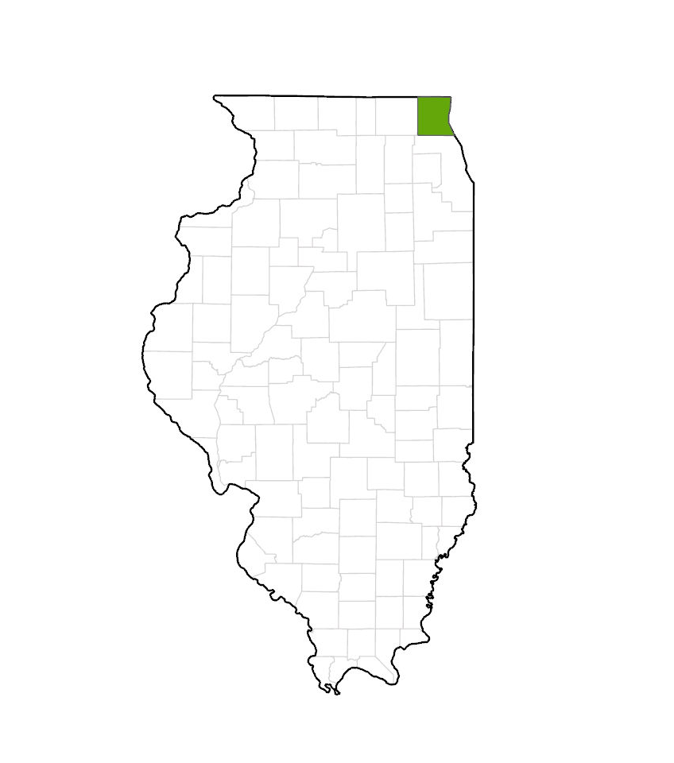
Lake County, IL
Third Largest County in Illinois
Suburb of Chicago
Approximately 705,000 residents
Lake County Health Department and Community Health Center (LCHD/CHC)
Statutory public health entity
Provider of behavioral and physical health services
908 Full Time Employees
24 HI&T FTE’s
Approximately $84 million budget
~5 million HI&T bustget

Slide 4
Notes:
The start of 2020 looked like any other January at the Lake County Health Department and Community Health Center. But by March, our entire world had been turned upside down. The global Coronavirus Pandemic had been raging for three months by the time it reached Lake County. Like every other local health departments across the country, we mobilized a response of epic proportion. Our public health emergency operations center flew into action and began to organize our investigation, containment, and mitigation efforts. Our objective was simple: reduce the effects COVID-19 would have on our community.

Slide 5
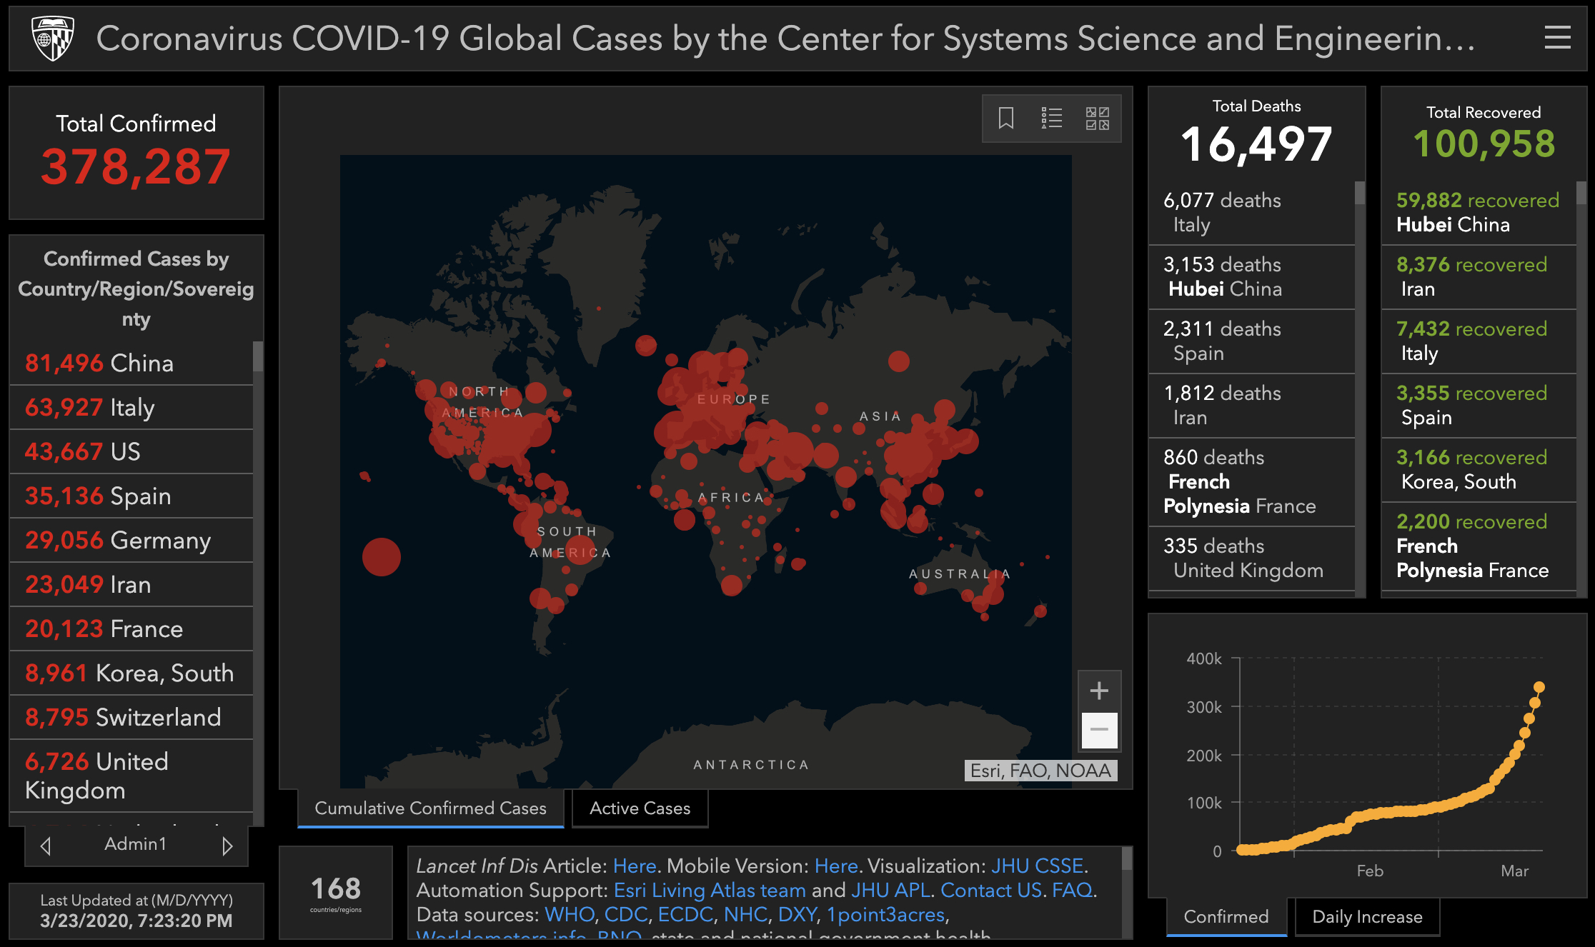
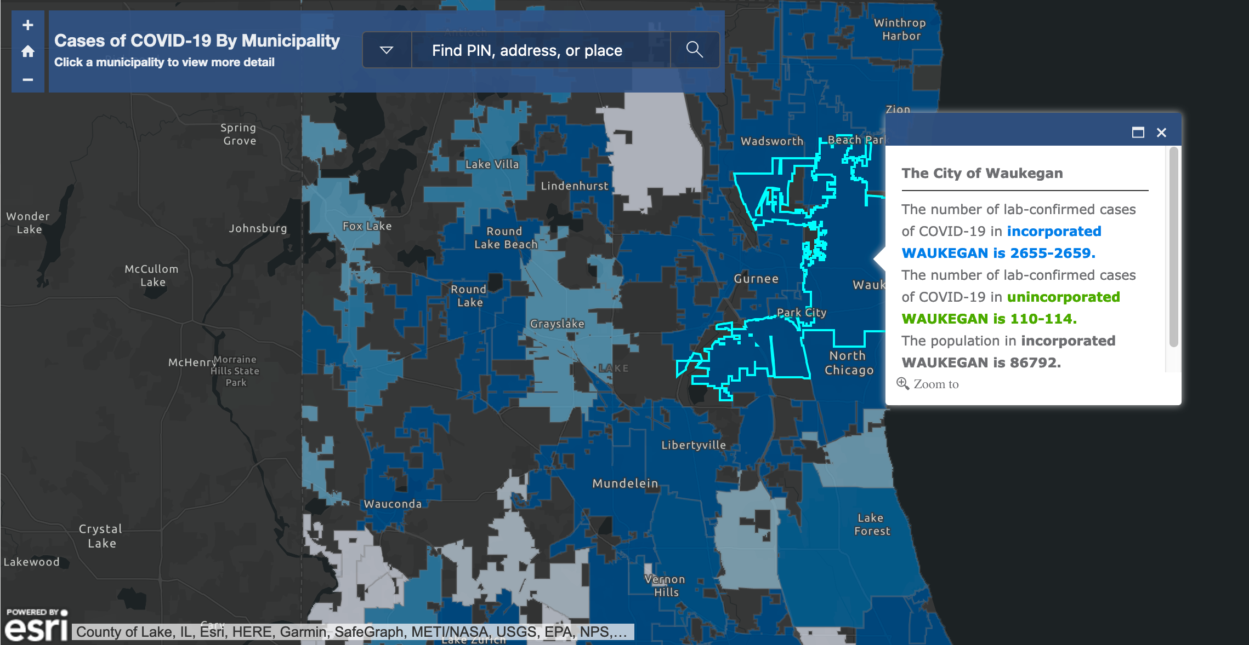
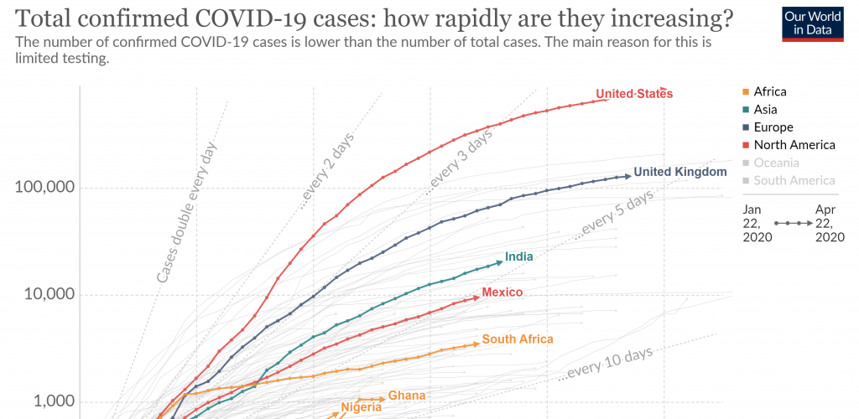
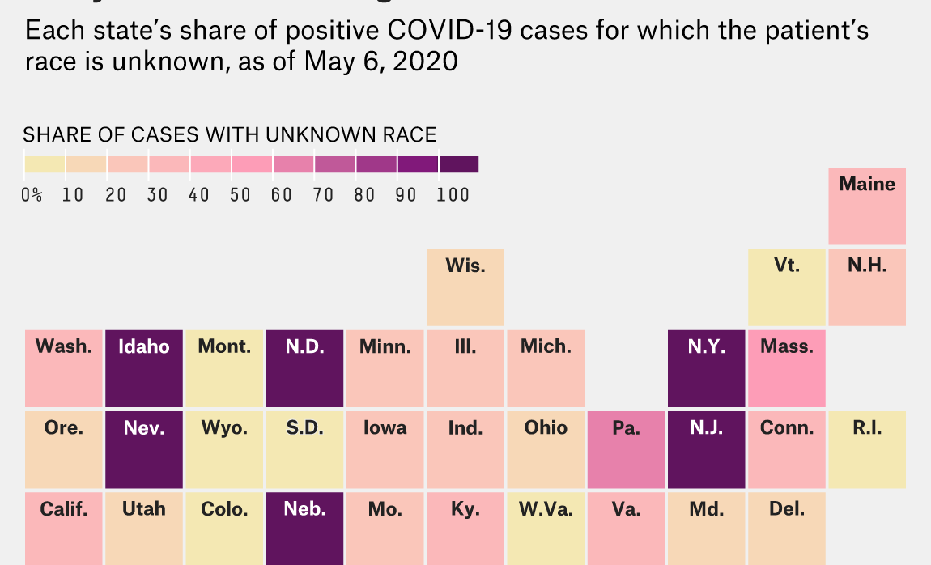
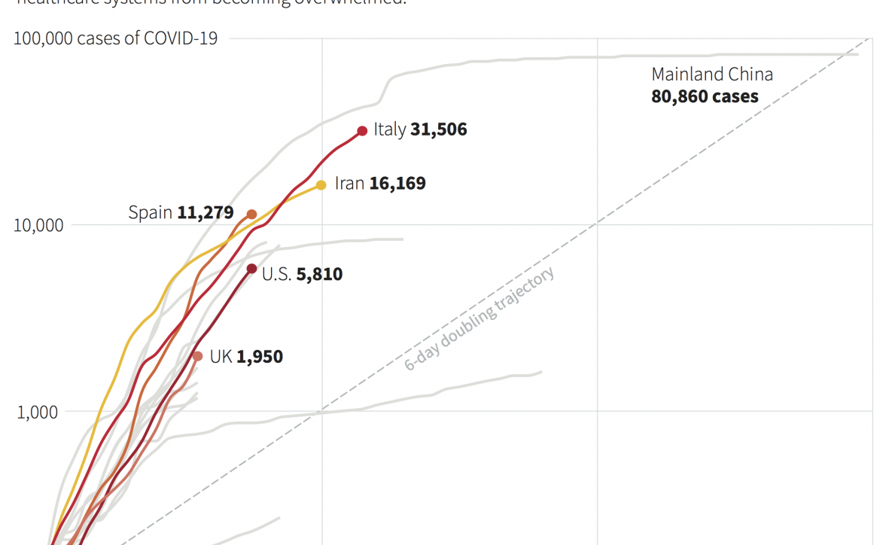
Notes:
The Coronavirus Pandemic, we quickly learned, is not just a pandemic of infection but also a pandemic of data. Community members and media inundated our local health department with requests for data and information. They wanted to know how many people were getting tested, how many people were getting infected, and how many people were dying. Those are all pieces of data we at health departments are very familiar with. However, the questions became more difficult for us as community members wanted to know where they should go shopping, were their children safe at school, and when it would be safe to resume a normal life. These questions required us to think outside of the box and begin to look for data we were not as familiar.
And we were not alone. Communities across the country were clamoring for data from their local, state, and federal health officials to calm their nerves. They want to know when things will get back to normal. But answering these types of questions is not something we in public health train for. They require us to think beyond the surveillance data we are used to working with and explore other ways to answer these tough questions. In other words, the hard questions asked during the current pandemic require us to think outside the four walls of our health department to data sources we do not collect, control, or maintain.

Slide 6
Think About
Data
Differently
Notes:
Thinking outside the four walls of our institutions is not innate and must be learned and practiced. It is a journey we in public health are all on together. What my colleagues have spoken about today and what this conference highlight is how many benefits this journey will yield. And we have plenty of examples in other industries that we can point to show that this journey is worth the effort. But they also highlights how long our journey might be. When we begin to think about interoperable data, health information exchanges, universal patient identifiers, and standardized ontologies for systematic public health problems, the list can get intimidating. Many of us at local health departments will look at that list and think this task impossible. And while those are all worthy endeavors that will help us tackle those "sticky" public health challenges and are critical things that we as an industry must work towards, they will take time. And if the current pandemic taught me one thing, it is that time is not something we have an abundance of.
We cannot wait until we have interoperability wholly figured out, until every state has a health information exchange, or until we have a national patient identifier across this country. No, the challenges you and I face today and will continue to face in the future demand our attention and require looking outside our health department's four walls for answers. But where do we begin?
When faced with this question at LCHD, my team I looked to one of the core parts of public health; assessing our communities health. We decided to reimag how we approached our community health assessment. We asked the question of how we could ever understand our communitie's health and well-being without taking into account the entire environment in which they live, work, and play? We needed data and information on all aspects of a person's being in order to assess the health of our community wholeheartedly. It requiered thinking about data differently and not relying on the traditional datasets my team and I were used to.
Without all the guardrails and infrastructure talked about today, reimagining how you all might conduct your community health assessments can seem daunting. And yes, doing it alone would be. But I can assure you that your communities are made up of people and organizations who have the data you need and the expertise to analyze it. That is why part of making the shift to thinking outside the four walls of your health department is embracing that you cannot do this alone. We all need community partners to supply the data and partner with us to analyze and contextualize it. Our community partners can no longer be just partners in developing and implementing interventions but deeply involved in the provision of new and novel data sources.
We have embraced this idea at LCHD by incorporating data sharing into the heart of our memorandums of understanding with our partners. When we form partnerships, we think about what data and information each partner can contribute to the greater whole. This has opened up our ability to access data from our community hospitals and social services. It will also open up the ability for us to leverage data from our business and non-profit partners. We recognize that we each have a small piece of the puzzle to contribute to the whole. We acknowledge that each person's data contribution is unique and serves to shine a light on one part of our community. However, when leveraged together, our data and collective minds create a beautiful, complete image of our community's health and well-being.

Slide 7
Notes:
When I first started in healthcare, this was an idea I screamed from the rooftops of the hospitals I worked with. Back then, we did not have a word like "social determinants of health," but we knew the data we were collecting on our patients was not enough to help us keep them healthy. We had to move outside of the data we collected within our four walls and begin to partners with other institutions that had new and exciting data to complete the picture of our patients. This path took us, literally, out of the four walls and into our city streets as we were trying to understand why so many children were experiencing acute scald burns. When we married our electronic health record data with the city's parcel and building data, we found a surprising correlation.

Slide 8
Notes:
Most of the children who experienced scald burns lived on the lower floors of multi-story apartment complexes. In talking with landlords, it seems several were keeping the hot water temperatures up high to assure the top floors received water that was appropriately hot. This inadvertently resulted in children experiencing scald burns at an alarming rate. The fix to prevent further burns from happening was simple. However, it necessitated new data sources for us to understand the problem at hand fully. It was not automatic for me to search for data outside our EHR, but it proved pivotal in preventing these and many other conditions.

Slide 9
Community Health Assessment
Notes:
Thinking outside the four walls of our institutions is not innate and must be learned and practiced. It is a journey we in public health are all on together. What my colleagues have spoken about today and what this conference highlight is how many benefits this journey will yield. And we have plenty of examples in other industries that we can point to show that this journey is worth the effort. But they also highlights how long our journey might be. When we begin to think about interoperable data, health information exchanges, universal patient identifiers, and standardized ontologies for systematic public health problems, the list can get intimidating. Many of us at local health departments will look at that list and think this task impossible. And while those are all worthy endeavors that will help us tackle those "sticky" public health challenges and are critical things that we as an industry must work towards, they will take time. And if the current pandemic taught me one thing, it is that time is not something we have an abundance of.
We cannot wait until we have interoperability wholly figured out, until every state has a health information exchange, or until we have a national patient identifier across this country. No, the challenges you and I face today and will continue to face in the future demand our attention and require looking outside our health department's four walls for answers. But where do we begin?
When faced with this question at LCHD, my team I looked to one of the core parts of public health; assessing our communities health. We decided to reimag how we approached our community health assessment. We asked the question of how we could ever understand our communitie's health and well-being without taking into account the entire environment in which they live, work, and play? We needed data and information on all aspects of a person's being in order to assess the health of our community wholeheartedly. It requiered thinking about data differently and not relying on the traditional datasets my team and I were used to.
Without all the guardrails and infrastructure talked about today, reimagining how you all might conduct your community health assessments can seem daunting. And yes, doing it alone would be. But I can assure you that your communities are made up of people and organizations who have the data you need and the expertise to analyze it. That is why part of making the shift to thinking outside the four walls of your health department is embracing that you cannot do this alone. We all need community partners to supply the data and partner with us to analyze and contextualize it. Our community partners can no longer be just partners in developing and implementing interventions but deeply involved in the provision of new and novel data sources.
We have embraced this idea at LCHD by incorporating data sharing into the heart of our memorandums of understanding with our partners. When we form partnerships, we think about what data and information each partner can contribute to the greater whole. This has opened up our ability to access data from our community hospitals and social services. It will also open up the ability for us to leverage data from our business and non-profit partners. We recognize that we each have a small piece of the puzzle to contribute to the whole. We acknowledge that each person's data contribution is unique and serves to shine a light on one part of our community. However, when leveraged together, our data and collective minds create a beautiful, complete image of our community's health and well-being.

Slide 10
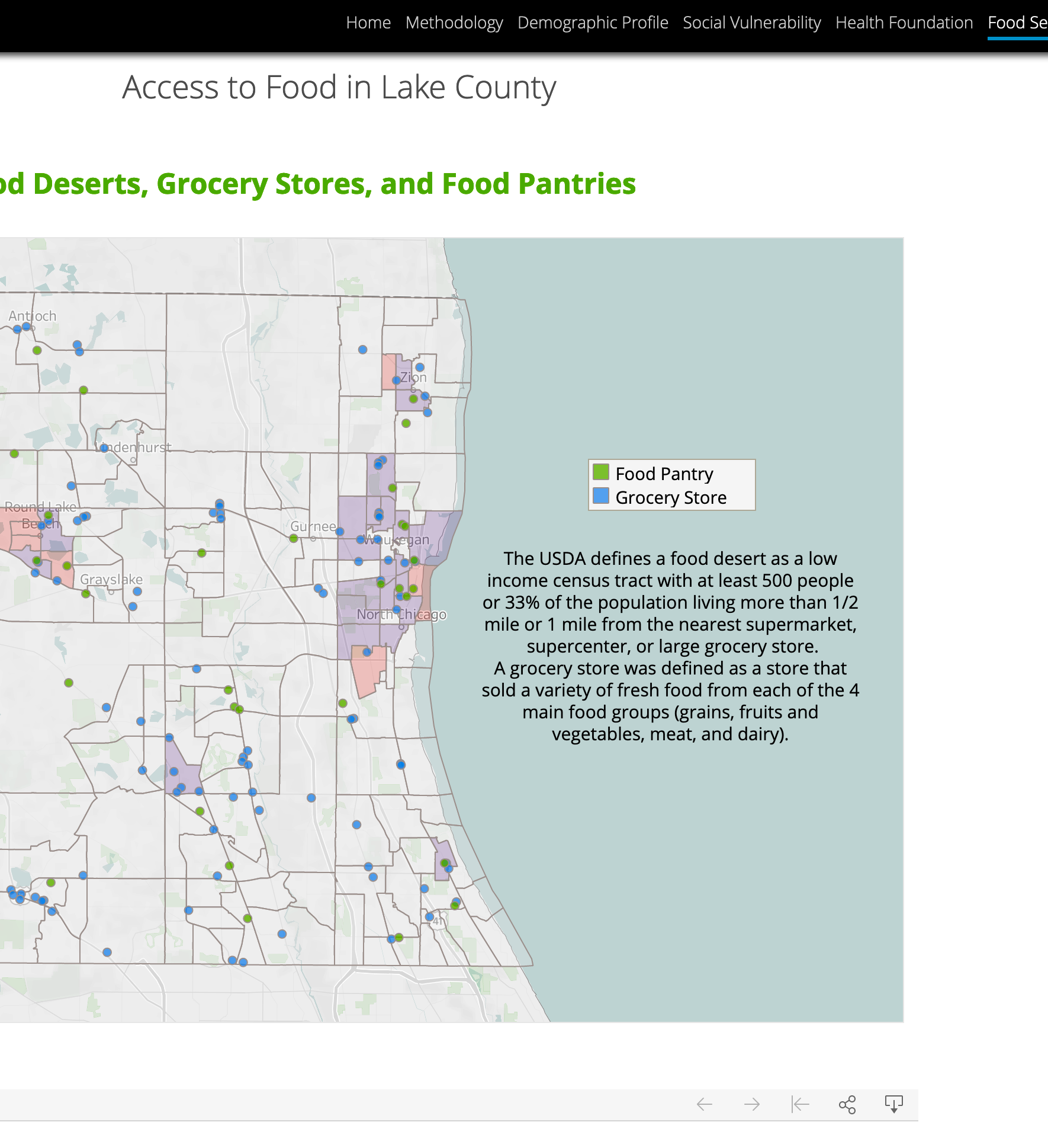
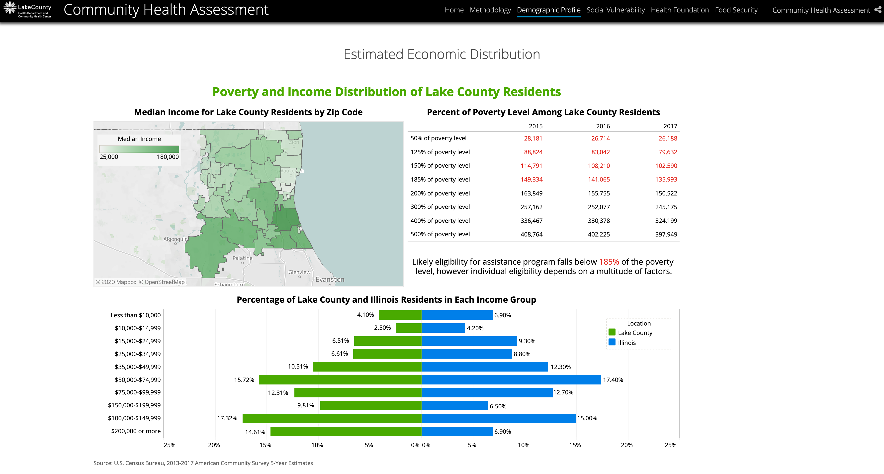
Notes:
Like any beautiful picture, though, we are compelled to share it with our community members and the world. You see, an essential facite of reframing our thinking outside the four walls of our public health department is understanding how empowering data can be. The person, community, or entity that has the data controls the story. When you control the story, you control the power. That is why it is so important that we share our data back with our community members. In doing so, we empower them to make informed decisions about their health, both individually and collectively. There is,of course, an education component that local health departments must be intentional about. It is challenging to communicate data in a way that our community understands. Every community member has their own expertise. Not everyone has an MPH and the background to understand the difference between incidence and prevalence or how age-adjustment works and why it is so important. So it is our job to educate them and bring our communities on our data journey with us. They are not just along for the ride but are a critical contributor to our journey's success.
At LCHD, we are working with our communities to empower them with data. This year, we will be launching the Lake County Health Data Portal, a one-stop-shop for our community members to find health-related data and a plethora of resources to help them interpret it. In creating the data portal, we have learned that communicating data to our community is not easy. It takes time and intentionality to assure the data can be used. That is why we have also engaged key community leaders, especially those in minority communities and communities of color, to communicate and present the information to the community. The local health department provides the support structures needed for these community leaders to understanding and contextualizes the data. The community leaders themselves help to translate that information, both literally and figuratively, to the community. Both pieces we have learned are necessary to truly help the data tell their story. These actions have helped us engage our community in ways we could never have imagined and empower us to work towards a healthier Lake County collectively.

Slide 11
Think About Data Differently
Facilitate Data Access
Engage Your Community in Your Data Journey
Contextualize Data with Lived Experience

