Slide 2
Local Health IT CoP
Agenda
April 25, 2019
Introductions
Priority 1: Cybersecurity
Priority 2: Upcoming meet up at NACCHO Annual
Priority 3: Updates to LHIT Virtual Conference
Other opportunities

Slide 3
Introductions
Name
Local Health Department
[First-timers] What would you like to learn from this group?

Slide 4
Cybersecurity
According to the World Economic Forum’s 2018 Global Risks Report, the top risks to global stability over the next five years:
Natural disasters
Extreme weather
Cyber attacks

Slide 5
Cybersecurity
What is the likelihood that you or your organization will be compromised by a successful cyberattack?

Slide 6
Cybersecurity
Source: Varonis

Slide 7
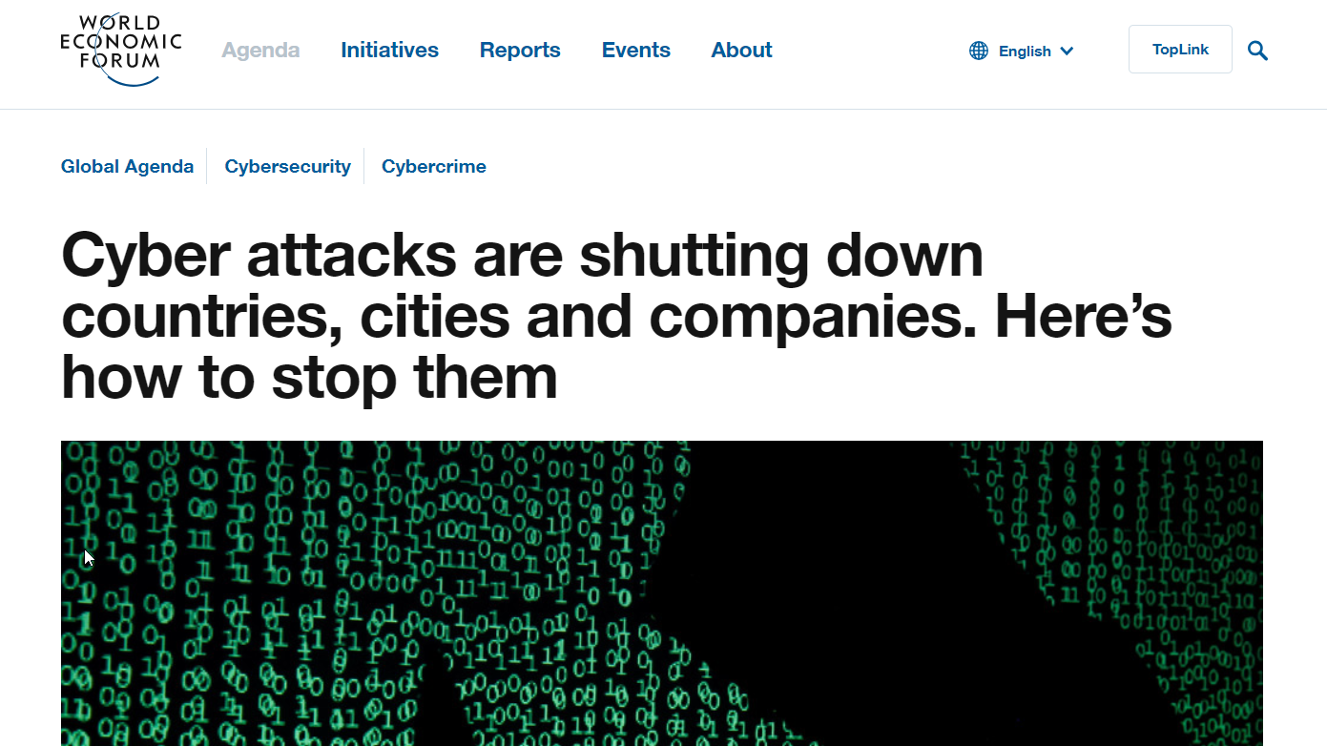
Cybersecurity
The FBI reports that more than 4,000 ransomware attacks occur daily, while other research sources state that 230,000 new malware samples are produced every day.
Source: WEF

Slide 8
Cybersecurity
Question now isn't if we'll be attacked, but how.
Gartner forecasts that industry spend in 2018 will reach $93 billion, as traditional security measures such as firewalls and anti-virus software prove to be inadequate.
The average cost of a data breach is estimated to exceed $150 million by 2020.

Slide 9
Cybersecurity
LHD THREATS LANDSCAPE
• Spam
• Spear Phishing & Phishing Attacks
• Malicious & Careless Insiders
• Malware
• Ransomware

Slide 10
Cybersecurity
BREACHES
• 80% of all data breaches involve compromising an employee credentials – majority through email
• Notable Breaches
– Atlanta, GA – Oklahoma Department of Securities – Alaska Dept. of Health & Human Services (Public Assistance) – Mecklenburg County, NC – Jackson County, GA – Orange County, NC

Slide 11
Cybersecurity

Slide 12
Cybersecurity

Slide 13
Cybersecurity

Slide 14
Cybersecurity

Slide 15
Cybersecurity

Slide 16
Cybersecurity

Slide 17
Cybersecurity

Slide 18
Cybersecurity

Slide 19
Cybersecurity

Slide 20
Cybersecurity

Slide 21
Cybersecurity

Slide 22
Cybersecurity

Slide 23
Tools
Highlight: Cybersecurity Preparedness Considerations for Healthcare Professionals
Have you used this tool before? Is this helpful for you?
Leave a review to help other LHD staff.

Slide 24
Tools
Are there tools that would be helpful to create or share?
Are there existing tools that would be helpful to share with the group now?

Slide 25
Virtual Communities
We have an online community space at http://bit.ly/localhealthit
Place where you can ask questions and bring up your projects
Share resources, tools, and events

Slide 26
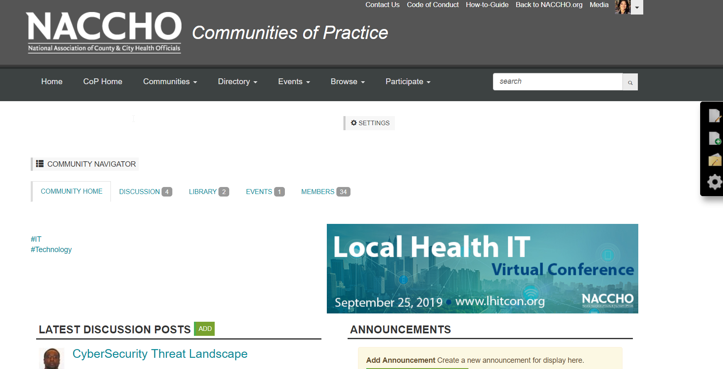
Virtual Communities
How to login
Navigate the website
Update profile
Change your email settings
Find resources and events

Slide 27
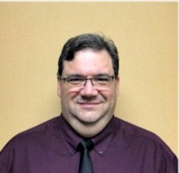
Virtual Communities
Ask Me Anything – Chris Collinge
Chris Collinge is the Director of Information Technology for the Florida Department of Health in Orange County.
This state health department is one of 67 counties and is located in Orlando, FL. His team has developed innovative strategies for state-wide IT projects and standardizations for mobile and tablet technologies for use with their EHR system.
Mr. Collinge received a Model Practice Award from the NAACHO for Qflow client tracking system. His leadership in developing systems to support medication reconciliation and clinical decision support has impacted patients across the state and helped support the work of the 18,000+ employees in the Florida Department of Health.

Slide 28
Virtual Communities
Current Projects:
Migration of DOH Orange data center to Windows Azure.
Migration of ACF Qflow client flow tracking system for 12 counties to Microsoft Azure.
Currently lead in rolling out Telehealth to DOH Florida for 67 counties.

Slide 29
Virtual Communities
May AMA
Do you have a Model Practice, potential Model Practice, or good information to share?
Don't be shy: Let us know!
Get feedback, boast about a good project, or share expertise.

Slide 30
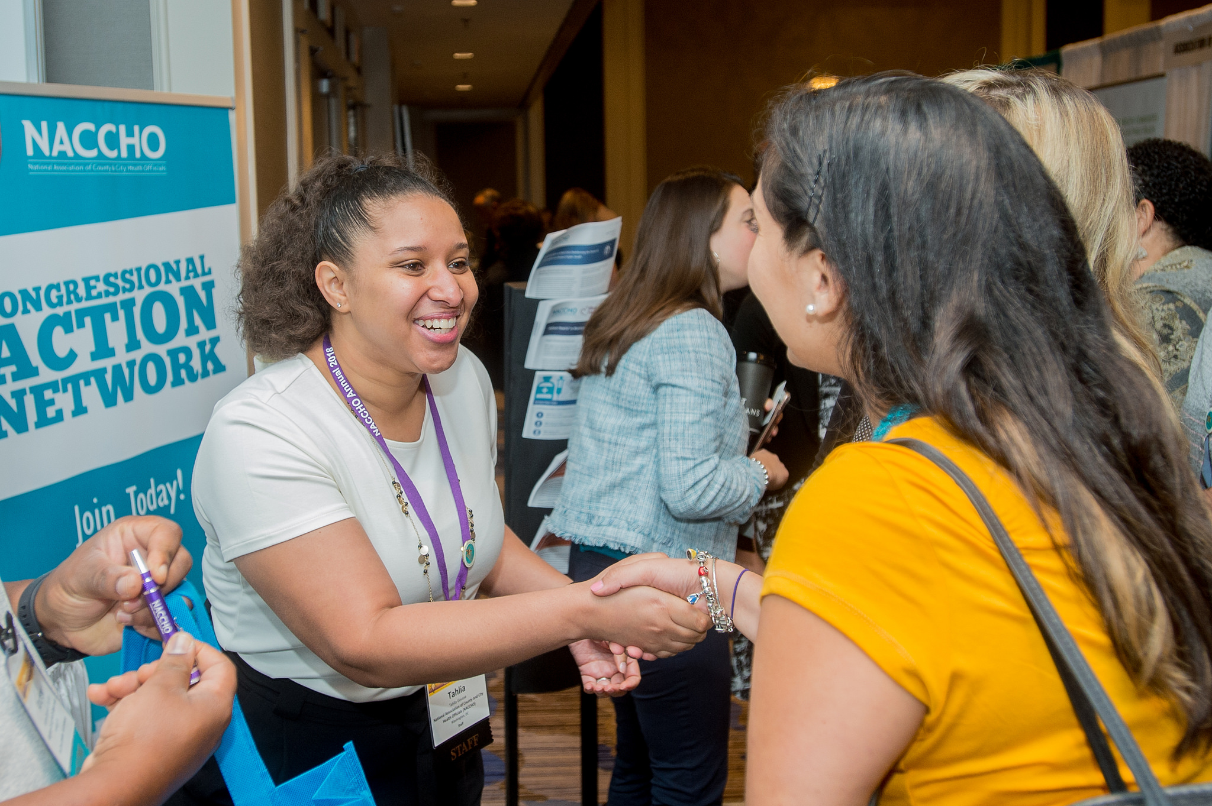
Meet Up at NACCHO Annual
Connecting on Weds, July 10 from 3-5pm
5-minute lightning round presentations
Light refreshments
Local Health IT goodies
Spread the Word

Slide 31
Meet Up at NACCHO Annual
Would you wear this?

Slide 32
LHIT Virtual Conference
Topics/Speakers – IT Staff
Registration opening soon
Topics: Hyperconvergence, cybersecurity, interoperability
Upcoming Webinars
Informatics
Lessons on cybersecurity www.lhitcon.org

Slide 33
Volunteer and Speaking Opportunities
Shameless Plug
If you are interested in staying involved with the LHIT conference, we will be offering free attendance for volunteering about 4 hours per month, speaking opportunities, or helping us find advertisers. Contact amcpherson@naccho.org.

Slide 34
Next Meeting
May 23, 2019 at 1pm ET
New Zoom contact
Bring a friend

Slide 35
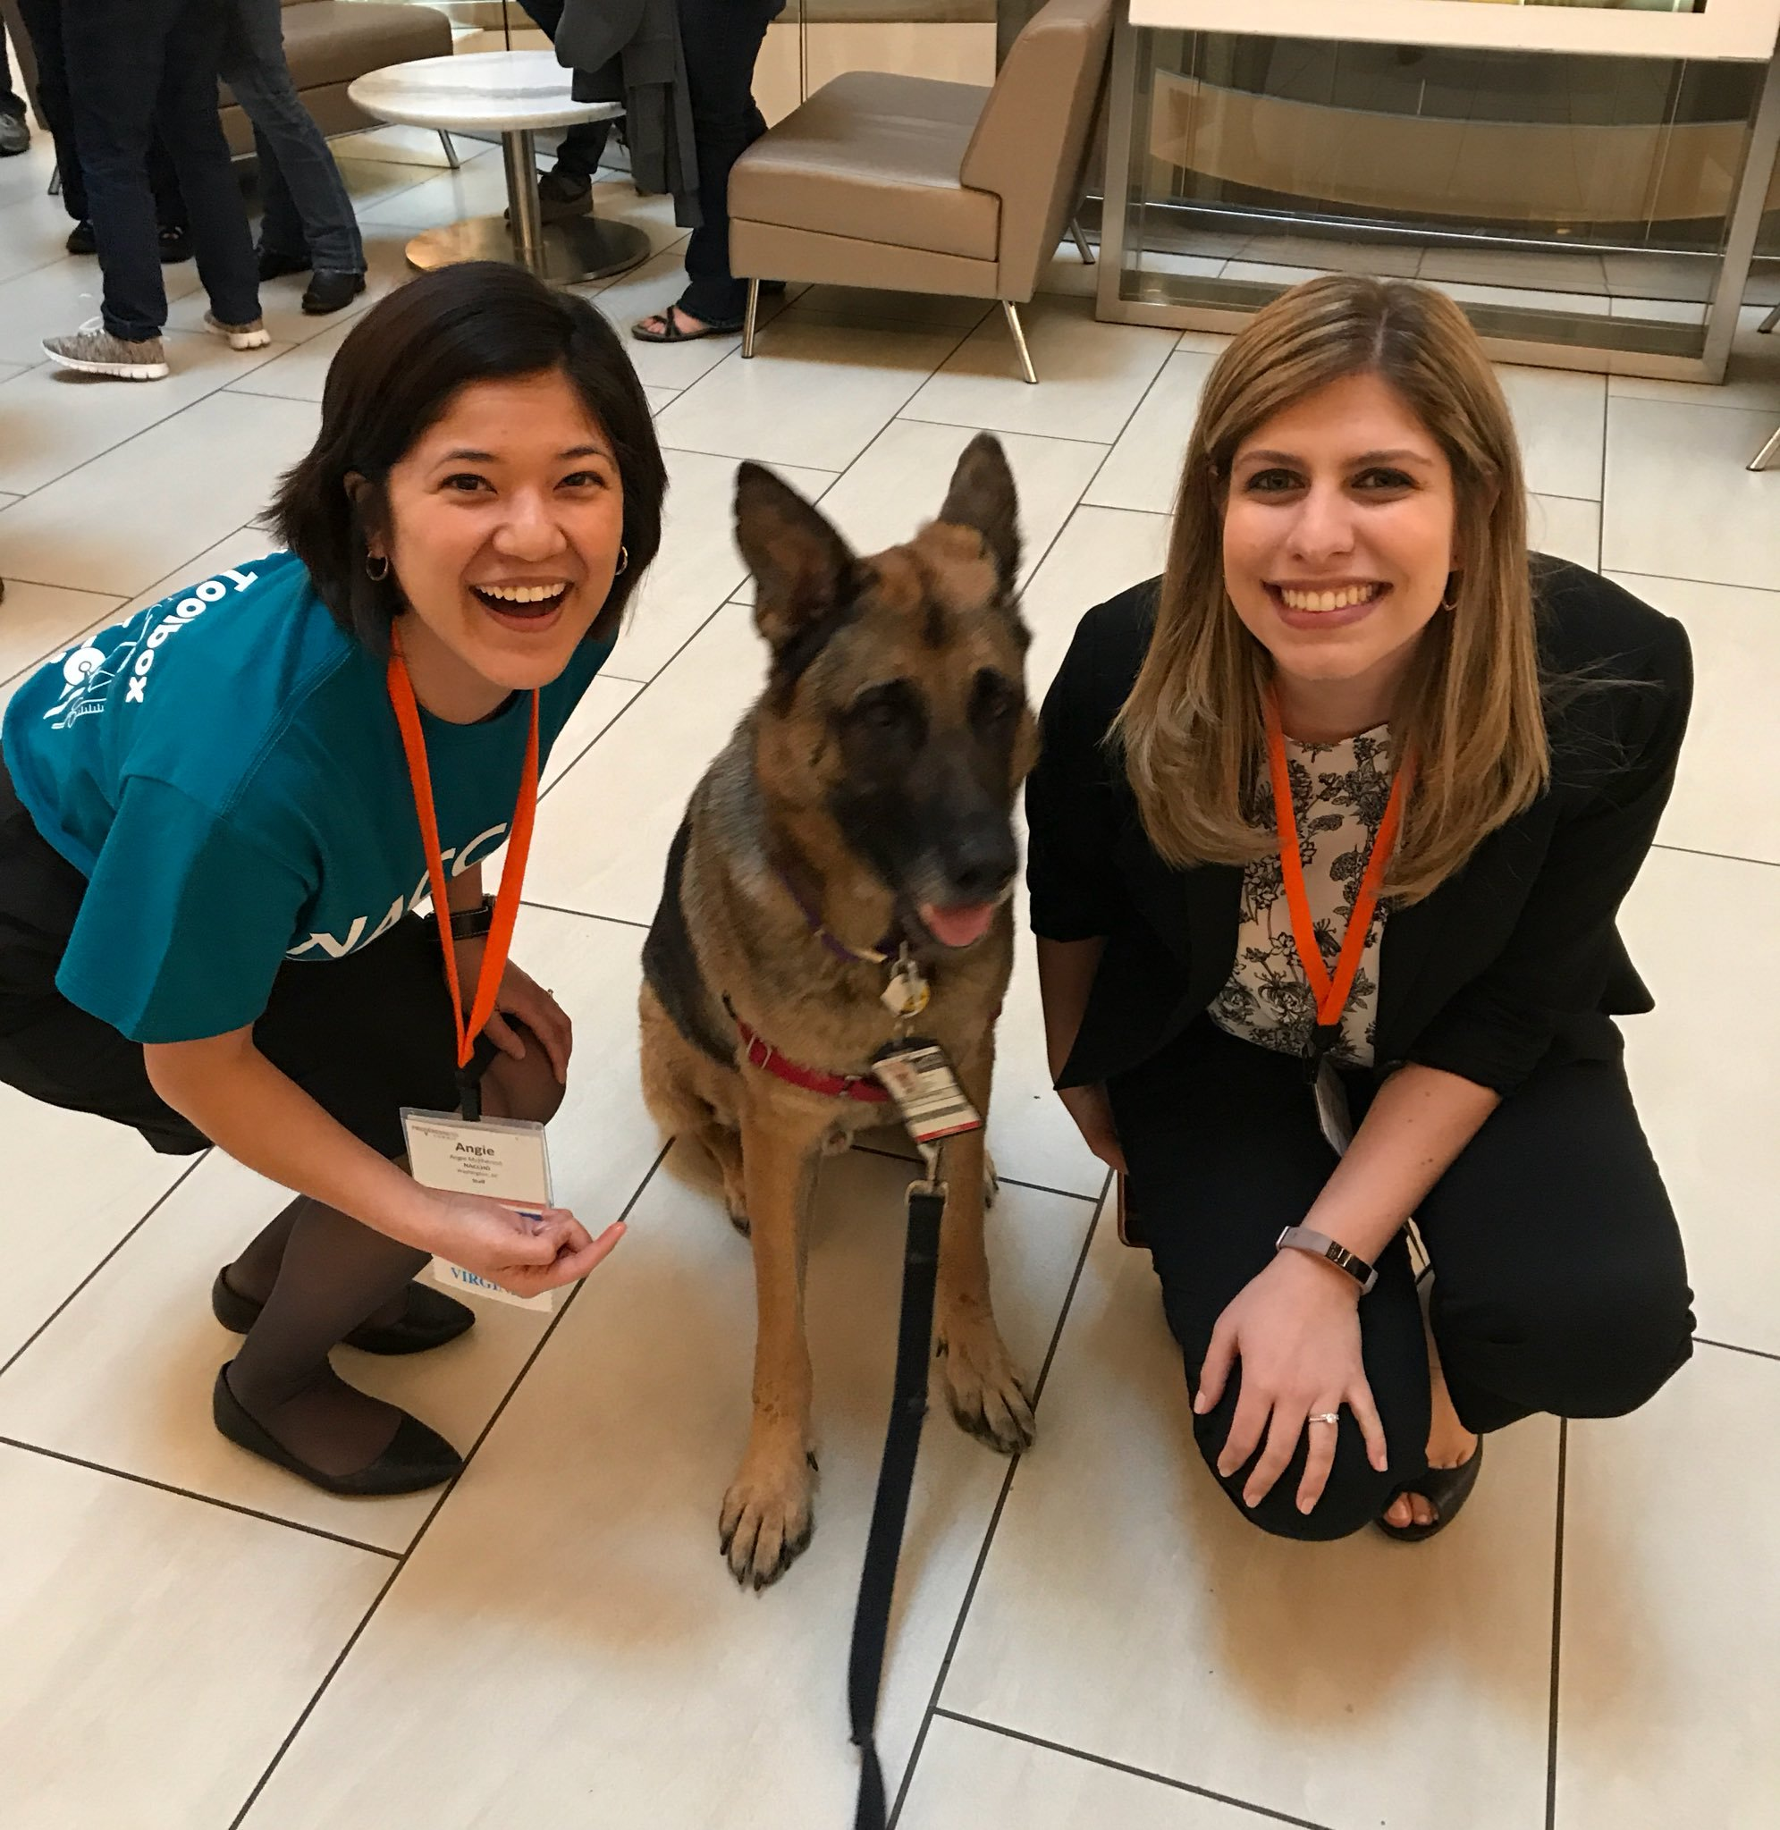
Questions or Comments
Angie McPherson
Any questions or comments about this CoP? Any overall website feedback, etc?
All additional comments and questions can be sent to amcpherson@naccho.org.

