Slide 1
Heavy Metals in Baby Food
Actions to move closer to zero
Jane Houlihan, Research Director

Slide 2
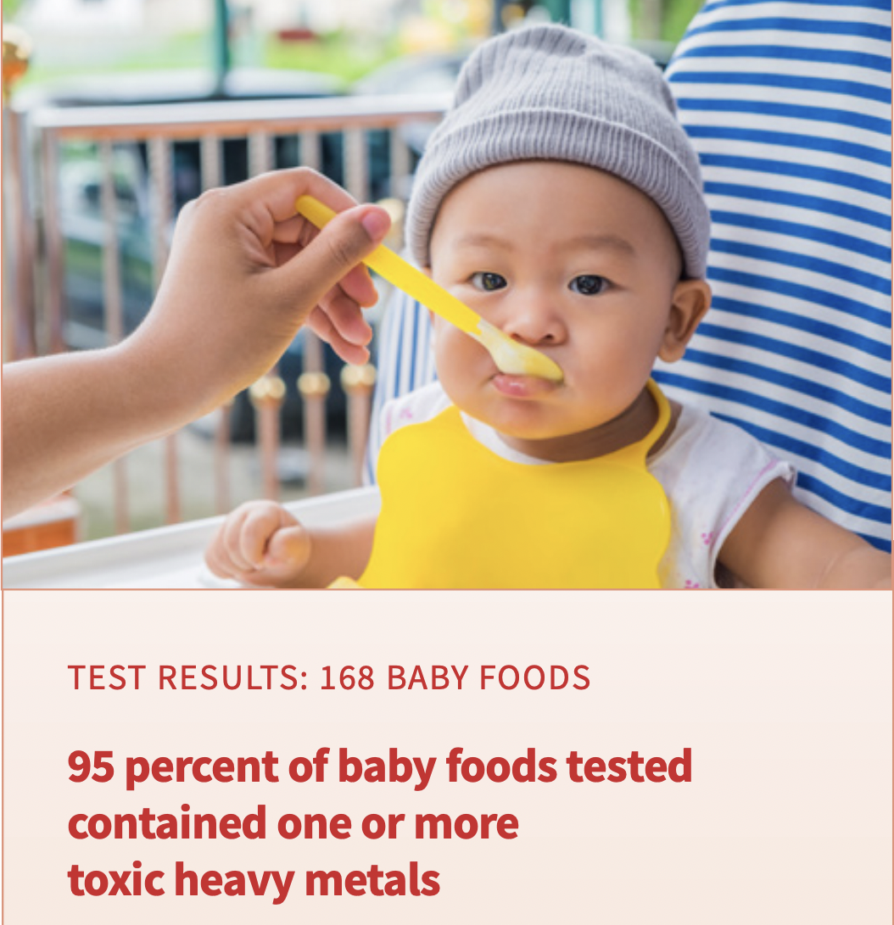
Nearly all foods babies eat are contaminated with heavy metals.

Slide 3
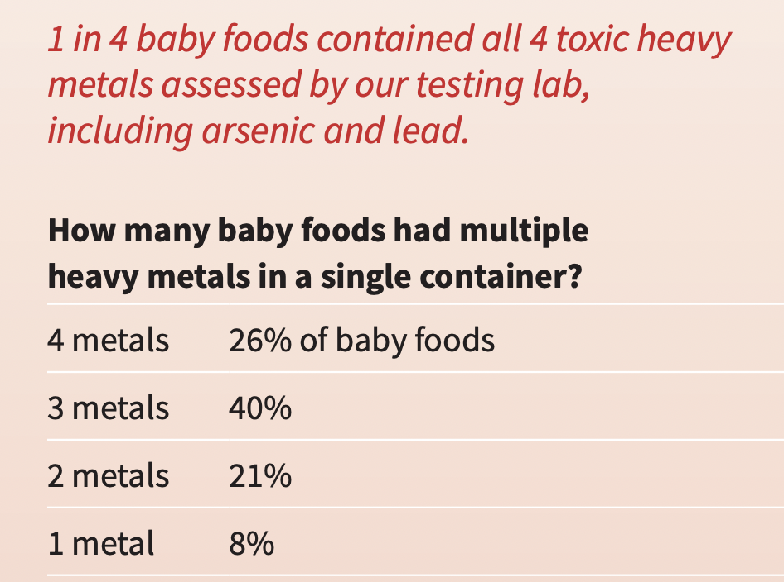
Most baby foods contain multiple heavy metals - lead, arsenic, cadmium, mercury

Slide 4
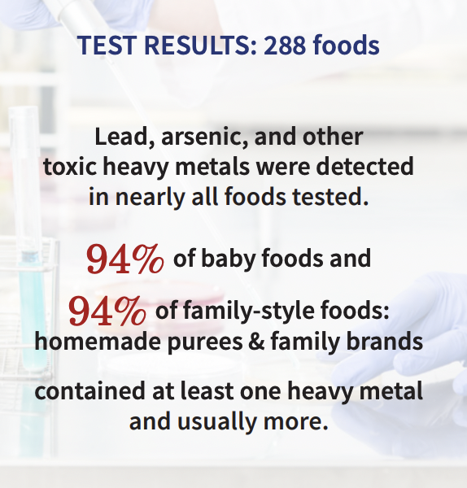
It’s not just commercial baby food - Homemade and organic foods are also a problem.

Slide 5
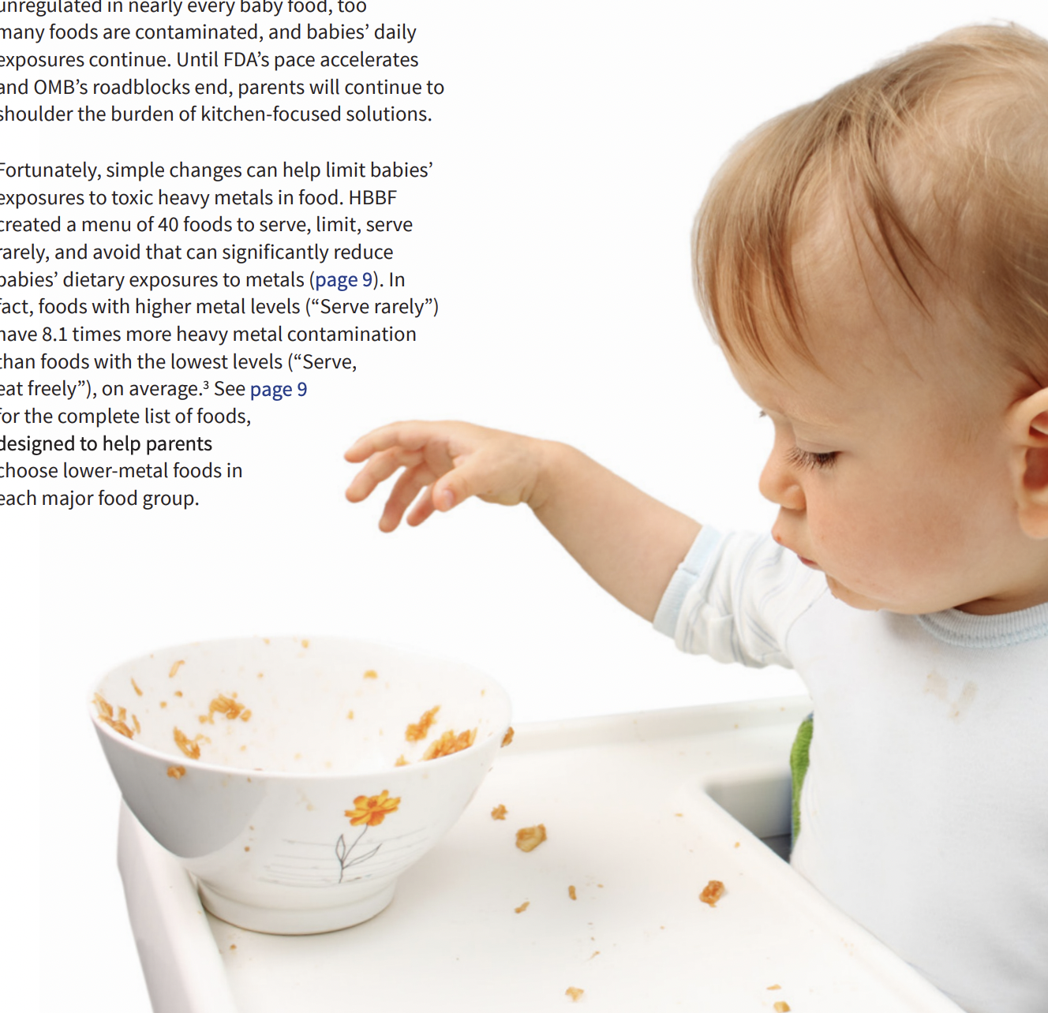
What is the concern?
The health risks associated with these heavy metals include lifelong deficits in intelligence and an array of social and behavioral problems. There is no known safe level of exposure.
These exposures raise concerns, but on the spectrum from worry to action, parents, companies, and the government can choose to act. While no amount of heavy metals is considered safe, less is better.

Slide 6
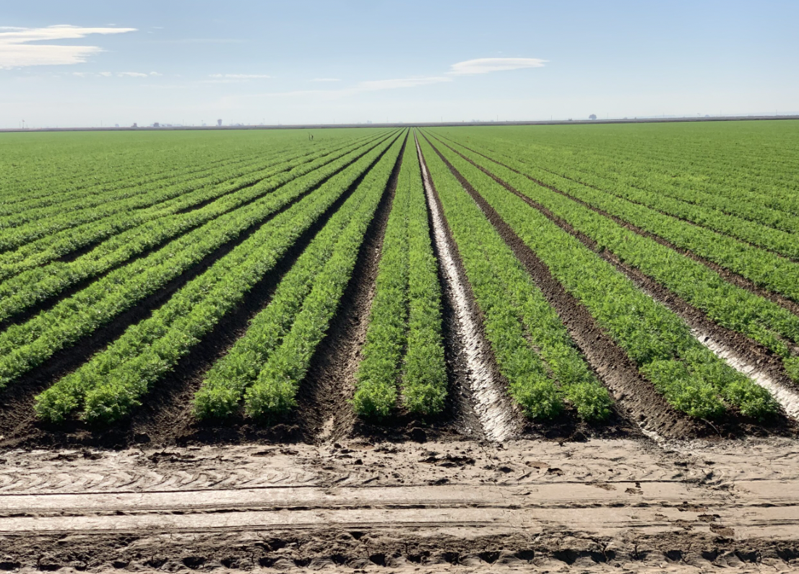
What is the source of contamination?
Heavy metals are naturally occurring in soil and water.
They are found at elevated levels in fields polluted by pesticides, contaminated fertilizer, airborne contaminants and industrial operations.
Food crops uptake these metals naturally.
Leafy greens and root crops like carrots and sweet potatoes retain more than most other types of fruits and vegetables.
How the food is processed may also affect the levels.

Slide 7
Which foods are contributing most?
Rice cereal is infants’ #1 source of arsenic exposure
Source: HBBF analysis of government data (EPA exposure factors, with government datasets on arsenic levels in food, water, and treated wood)

Slide 8
Which foods are contributing most?
Lead levels are highest in sweet potatoes, teething biscuits, and cookies (FDA 2020)
Juice
7.2%
Baby food
14.4%
Homemade baby food and other store-bought foods babies eat (not baby food brands)
51.4%
Infant formula
25.9%
Snacks
1.0%
Lead exposure from foods consumed by babies and young children (ages 0-2 years)
Total percentage of exposures by food group
Source: Abt Associates dietary lead exposure analysis, HBBF 2023.

Slide 9
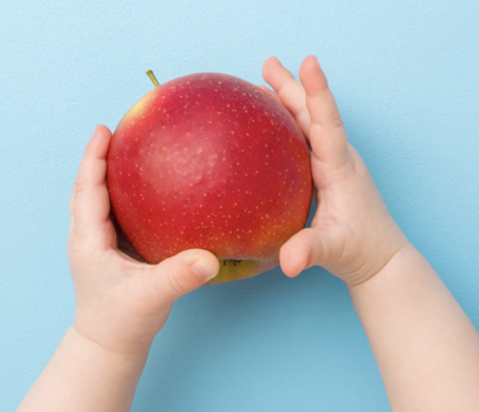
Solutions
Federal government
State WIC programs
Parents
Companies - growers, suppliers, manufacturers

Slide 10
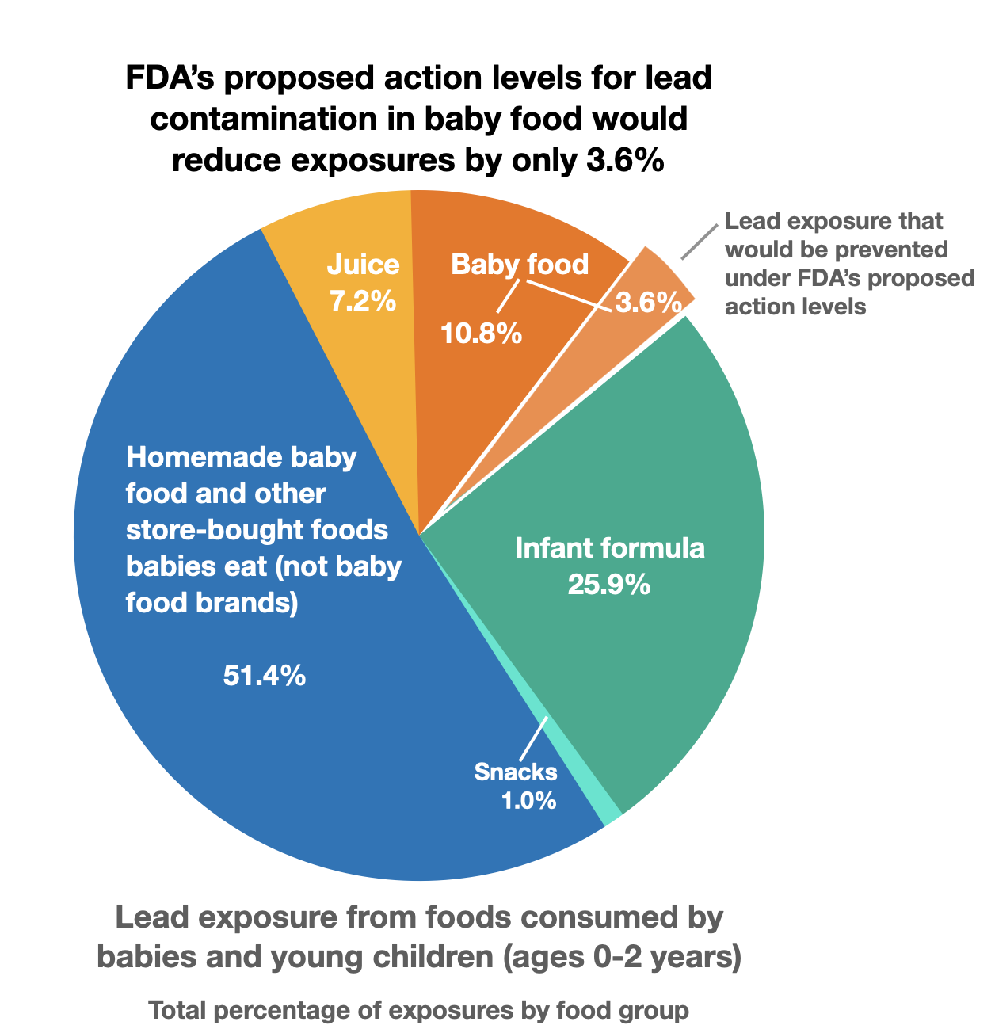
Solutions: FDA’s Closer to Zero Initiative
FDA’s Closer to Zero initiative intends to “help continually reduce toxic elements to the lowest levels possible in foods eaten by babies and young children.” Little progress has been made.

Slide 11
Solutions: State WIC Programs
Infant rice cereal has been removed from the WIC food lists in Oregon, Alaska, and Hawaii.
Oatmeal and multigrain cereals have far less arsenic and are available at the same price.

Slide 12
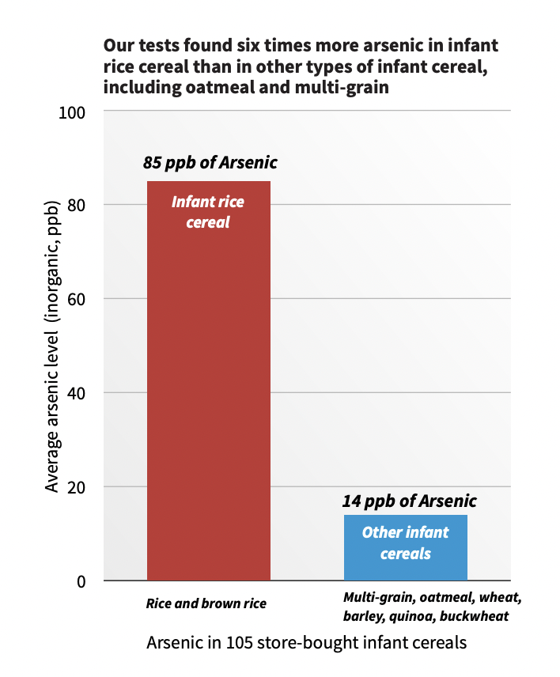
Solutions: State WIC Programs

Slide 13
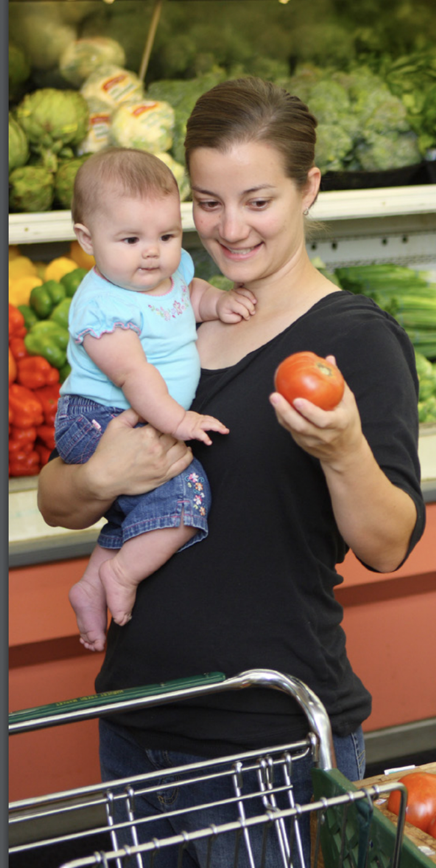
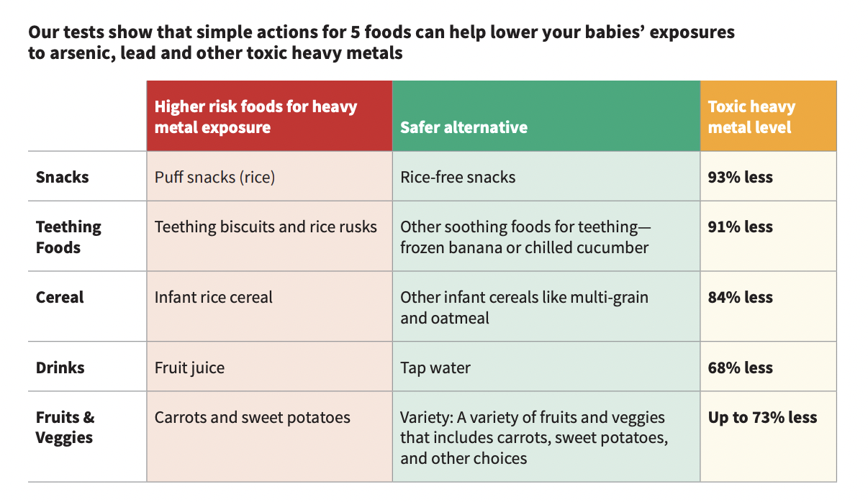
Solutions: Giving parents information to make safer choices

Slide 14
Solutions: Upstream
Growers can follow accepted best practices (soil amendments, crop varieties)
Suppliers and food manufacturers can test and choose growers that can provide safer ingredients.
Companies can invest in research to identify and evaluate methods to reduce heavy metals in products and ingredients.

Slide 15
For more information:
hbbf.org/solutions/healthy-baby-foods

