Slide 2
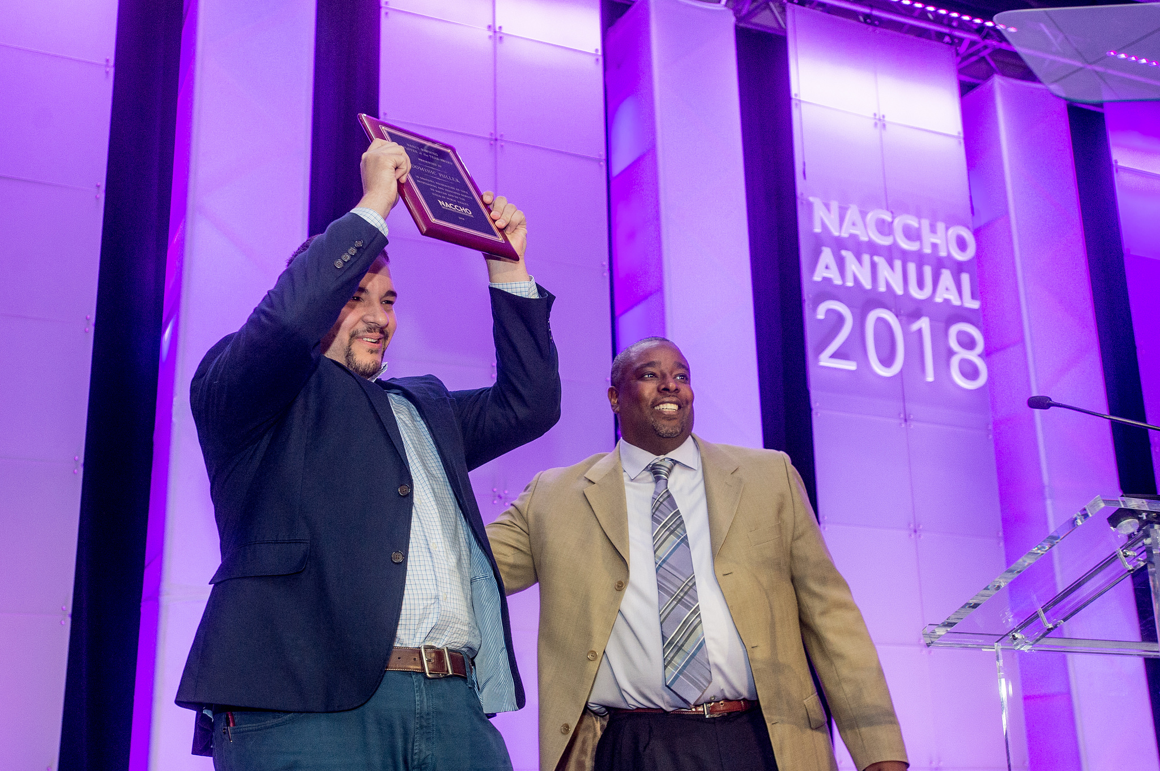
Introductions
Dennis Small
Chief Technology Officer at NACCHO
Responsible for NACCHO's IT infrastructure, websites, member database
This CoP was inspired by a site visit made to Orange County Florida

Slide 3
Local Health IT CoP
Agenda
Introductions: What is impacting your local health department?
Goals of the CoP
Priority 1: Discuss the LHIT Virtual Conference
Priority 2: Discuss potential speakers related to topics
Priority 3: Discuss tool suggestions
Priority 4: Volunteer opportunities, NACCHO Annual, and follow up

Slide 4
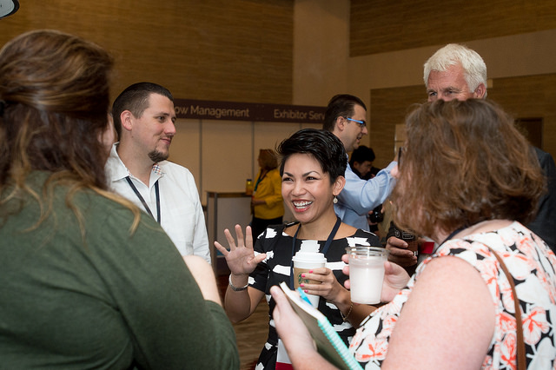
Introductions
We want to hear from you!
Introduce yourself: Title and organization
What interested you in this Community of Practice?
What are some IT issues that are impacting your community right now?

Slide 5
Goals of the Local Health IT CoP
Goals
To bring together local health IT departments from across the country to share tips and best practices
To discuss topics such as cybersecurity, interoperability, telehealth, hyperconvergence, and more

Slide 6
LHIT Virtual Conference
Vision
NACCHO Local Health IT 2019 will be an online space for IT staff to meet virtually and share replicable best practices with an emphasis on websites, social media, and other digital media.

Slide 7
LHIT Virtual Conference
IT Staff
Digital Staff
Local Health Officials
AUDIENCE

Slide 8
LHIT Virtual Conference
Goals
To bring together LHD to share best practices
To test interest in virtual events
To meet members where they are

Slide 9
LHIT Virtual Conference
Topics/Speakers – IT Staff
General Session: Interoperability
Security and Data Privacy
Hyperconvergence
Malware and Phishing Attacks
Telehealth
General Session: Health Data During Emergencies

Slide 10
LHIT Virtual Conference
Topics/Speakers – Digital Staff
General Session: Interoperability
Website Redesign
Accessibility
Web Tools
Social Media
General Session: Health Data During Emergencies

Slide 11
Tools
Are there tools that would be helpful to create or share?
Are there existing tools that would be helpful to share with the group now?

Slide 12
Volunteer and Speaking Opportunities
If you are interested in staying involved with the LHIT conference, we will be offering free attendance for volunteering about 4 hours per month. Contact amcpherson@naccho.org.
If you are attending NACCHO Annual, we will be hosting a lightning round presentation.

Slide 13
Next Meeting
April 25, 2019 at 1pm ET
Same contact information
Bring a friend

Slide 14
Virtual Communities
We have an online community space at http://bit.ly/localhealthit
Place where you can ask questions and bring up your projects
Share resources, tools, and events

Slide 15
Questions or Comments
Any questions or comments about this CoP?
All additional comments and questions can be sent to amcpherson@naccho.org.

