Slide 2
Local Health IT CoP
Agenda
May 23, 2019
Introductions
Priority 1: Lessons Learned from a Breach
Priority 2: Favorite Vendors / Platforms
Priority 3: NACCHO Annual / LHIT Virtual Conference
Other opportunities

Slide 3
Introductions
Name
Local Health Department
[First-timers] What would you like to learn from this group?

Slide 4
Introductions
Name / LDH / Favorite Avenger
[First-timers] What would you like to learn from this group?

Slide 5
Cybersecurity
Last month, we heard from Orange County, North Carolina.
On Monday, March 18, the Orange County Government computer system was affected by a virus.
Juliet Sheridan shared the lessons learned about their Continuity of Operations Plan (COOP)

Slide 6
Cybersecurity
Lessons learned included:
Continuity of Operations Plans (COOP) was inadequate
Needed redundancies for important docs and functions
Response team needed basic IT knowledge
Needed one Incident Lead to coordinate response
Interconnected data means shared risk
You can find the full presentation on Virtual Communities.

Slide 7
Cybersecurity
What is the likelihood that you or your organization will be compromised by a successful cyberattack?

Slide 8
Cybersecurity
Source: Varonis

Slide 9
Cybersecurity
BREACHES
• 80% of all data breaches involve compromising an employee credentials – majority through email
• Check out the list on HHS for Notable Breaches
– Atlanta, GA – Oklahoma Department of Securities – Alaska Dept. of Health & Human Services (Public Assistance) – Mecklenburg County, NC – Jackson County, GA – Orange County, NC – Orange County, FL – City of Baltimore

Slide 10
Cybersecurity

Slide 21
Tools
Highlight: Health Information Exchange Toolkit for Local Health Departments
Have you used this tool before? Is this helpful for you?
Are there better tools to share for HIPAA compliance?
Leave a review to help other LHD staff.

Slide 22
Tools
HHS Tool: Wall of Shame
Previous Highlight: Cybersecurity Preparedness Considerations for Healthcare Professionals

Slide 23
Tools
Are there tools that would be helpful to create or share?
Are there existing tools that would be helpful to share with the group now?

Slide 24
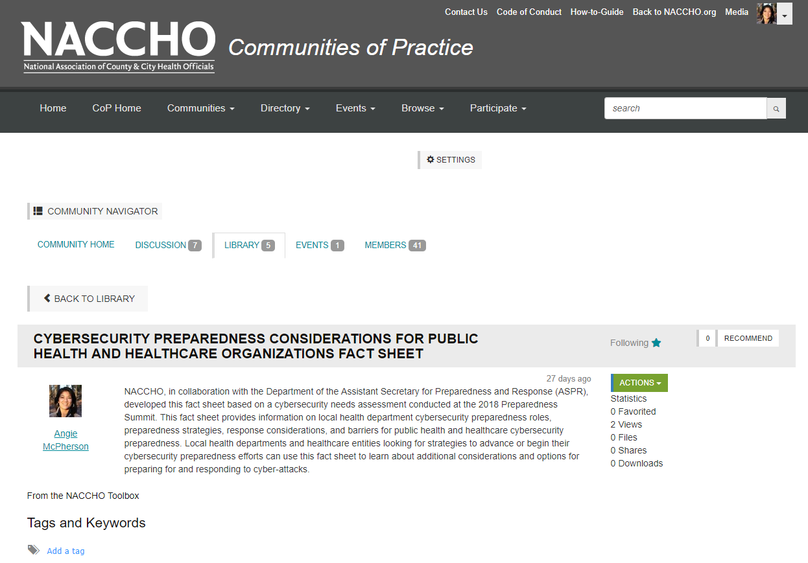
Virtual Communities
We have an online community space at http://bit.ly/localhealthit
Place where you can ask questions and bring up your projects
Share resources, tools, and events

Slide 25
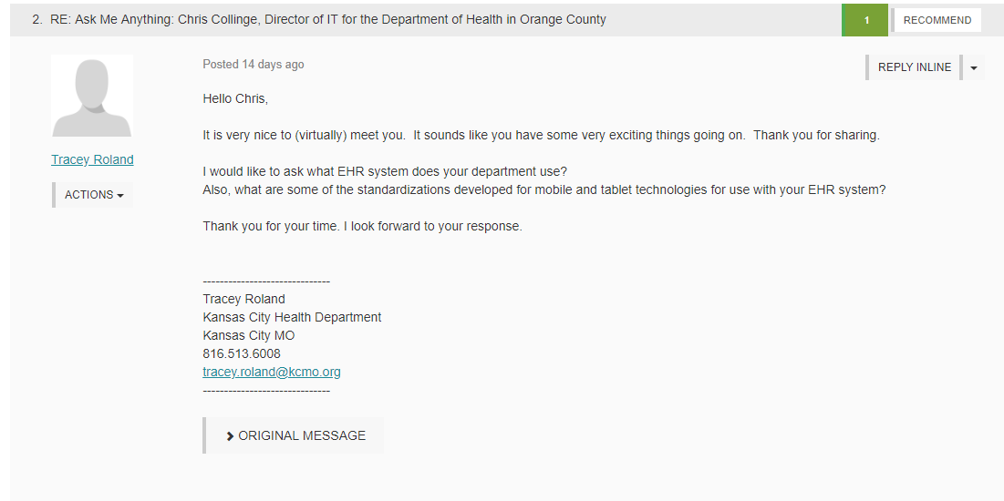
Virtual Communities
Last week, there was a discussions on experience with vendors, which inspired the next conversation.

Slide 26
LHIT Virtual Conference
Topics/Speakers – IT Staff
Registration opening first week June
Topics: Hyperconvergence, cybersecurity, interoperability
Upcoming Webinars
Informatics
Lessons on cybersecurity www.lhitcon.org

Slide 27
Your Vendors / Projects
We're Looking for LHIT Sponsors
What are some projects you'd like to highlight?
Who would you recommend as a sponsor for LHIT?
Are you in the market for platforms? If so, which ones?

Slide 28
Speaker Question
The Americans with Disabilities Act (ADA) requires State and local government agencies to provide accommodations for citizens with disabilities. ADA also applies to websites and mobile apps.
NACCHO members attending LHIT will have the opportunity to attend an information session with a digital accessibility expert to discuss the regulation and solutions to ensure your digital properties are accessible.
What kind of content are you interested in covering during the session? What questions do you have about what the law demands and solutions to remedy? How can your country website/app become compliant with ADA?

Slide 29
Meet Up at NACCHO Annual
Connecting on Weds, July 10 from 3-5pm
5-minute lightning round presentations
Light refreshments
Local Health IT goodies
Spread the Word

Slide 30
Meet Up at NACCHO Annual
Confirmed:
National Academies of Science: Sharing Data
Orange County: Q Flow
Tri-County: 2018 Model Practice winner on Opioids
Garrett County: Open Source Public Health Innovation
Potential:
Salt Lake County: Responsible Electronic Recycling
Others? Speakers?

Slide 31
Next Meeting
June Info
Discuss: What do you want to discuss about in the next meeting?
Do you have a Model Practice, potential Model Practice, or good information to share?
Don't be shy: Let us know!
Get feedback, boast about a good project, or share expertise.

Slide 32
Next Meeting
June 27, 2019 at 1pm ET
Bring a friend

Slide 33
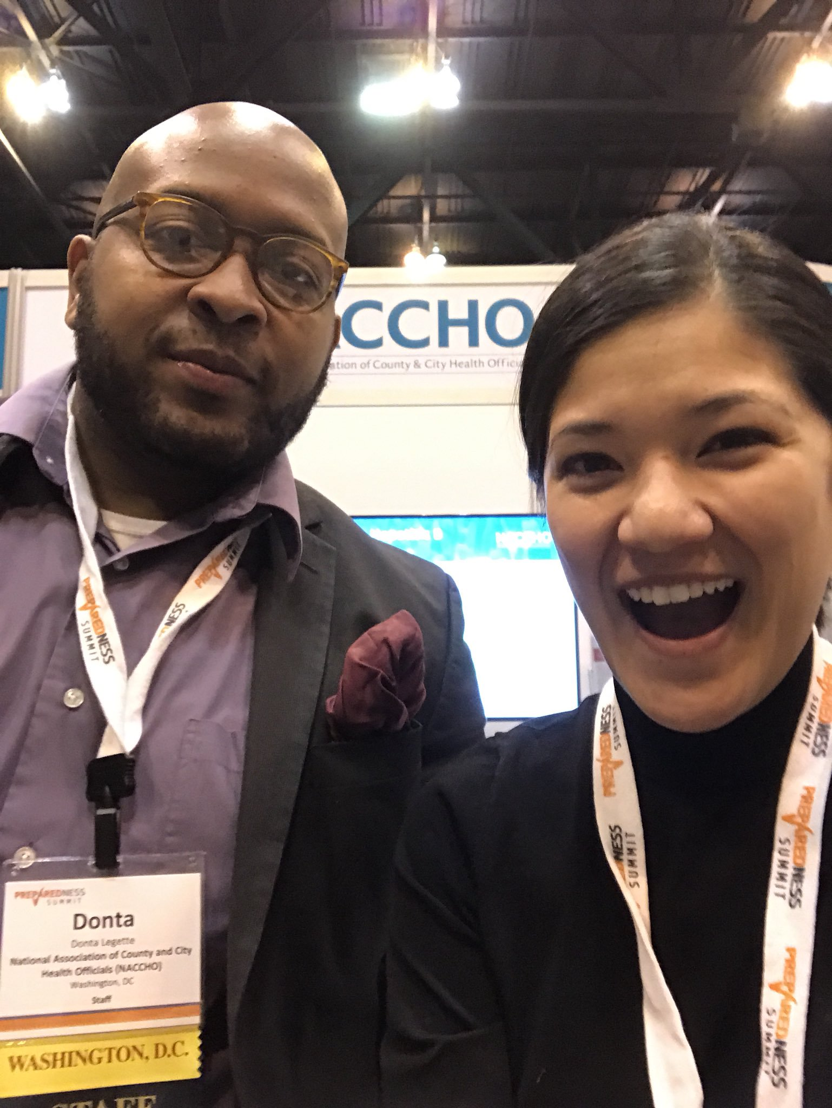
Questions or Comments
Angie McPherson
Any questions or comments about this CoP? Any overall website feedback, etc?
All additional comments and questions can be sent to amcpherson@naccho.org.

